Slide 1


Scalable and Low Overhead DRAM Read Disturbance Mitigation
Abdullah Giray Yağlıkçı
(on behalf of Ataberk Olgun)
The Future of Memory and Storage
August 6, 2024
Notes:
Hello everyone, welcome to my doctoral examination. Today, I will give a high-level overview of the work that I have done throughout my Ph.D.

Slide 2

Brief Self Introduction
Abdullah Giray Yaglikci
Researcher @ SAFARI Research Group since August 2016
ETH Zurich (Feb 2018 – ongoing)
Intel Labs (Aug 2017 – Feb 2018)
Carnegie Mellon University (Aug 2016 – Aug 2017)
Defended my PhD thesis, advised by Onur Mutlu, in April 2024
https://agyaglikci.github.io/
agirayyaglikci@gmail.com (Best way to reach me)
https://safari.ethz.ch
Research interests:
Computer architecture, hardware security
Memory and storage systems
Hardware security, safety, reliability, performance, availability, fairness, energy efficiency
Hardware/software cooperation
…

Slide 3
Papers in This Talk
Ataberk Olgun, Yahya Can Tugrul, Nisa Bostanci, Ismail Emir Yuksel, Haocong Luo, Steve Rhyner, Abdullah Giray Yaglikci, Geraldo F. Oliveira, and Onur Mutlu, "ABACuS: All-Bank Activation Counters for Scalable and Low Overhead RowHammer Mitigation” Proceedings of the 33rd USENIX Security Symposium (USENIX Security), Philadelphia, PA, USA, August 2024. [arXiv version] [ABACuS Source Code (Officially Artifact Evaluated with All Badges)] Officially artifact evaluated as available, functional, and reproduced.
F. Nisa Bostanci, Ismail Emir Yuksel, Ataberk Olgun, Konstantinos Kanellopoulos, Yahya Can Tugrul, A. Giray Yaglikci, Mohammad Sadrosadati, and Onur Mutlu, "CoMeT: Count-Min-Sketch-based Row Tracking to Mitigate RowHammer at Low Cost” Proceedings of the 30th International Symposium on High-Performance Computer Architecture (HPCA), April 2024. [Slides (pptx) (pdf)] [arXiv version] [CoMeT Source Code (Officially Artifact Evaluated with All Badges)] Officially artifact evaluated as available, reviewed and reproducible.

Slide 4
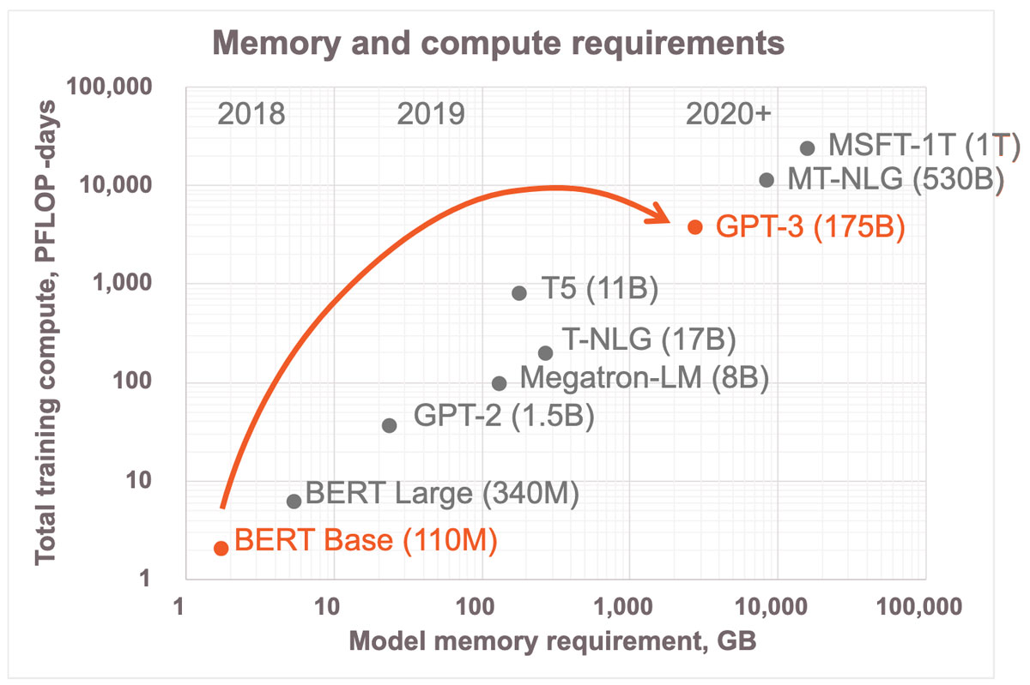
Memory & Generative AI (I)
Image Source: https://www.cerebras.net/blog/cerebras-architecture-deep-dive-first-look-inside-the-hw/sw-co-design-for-deep-learning

Slide 5
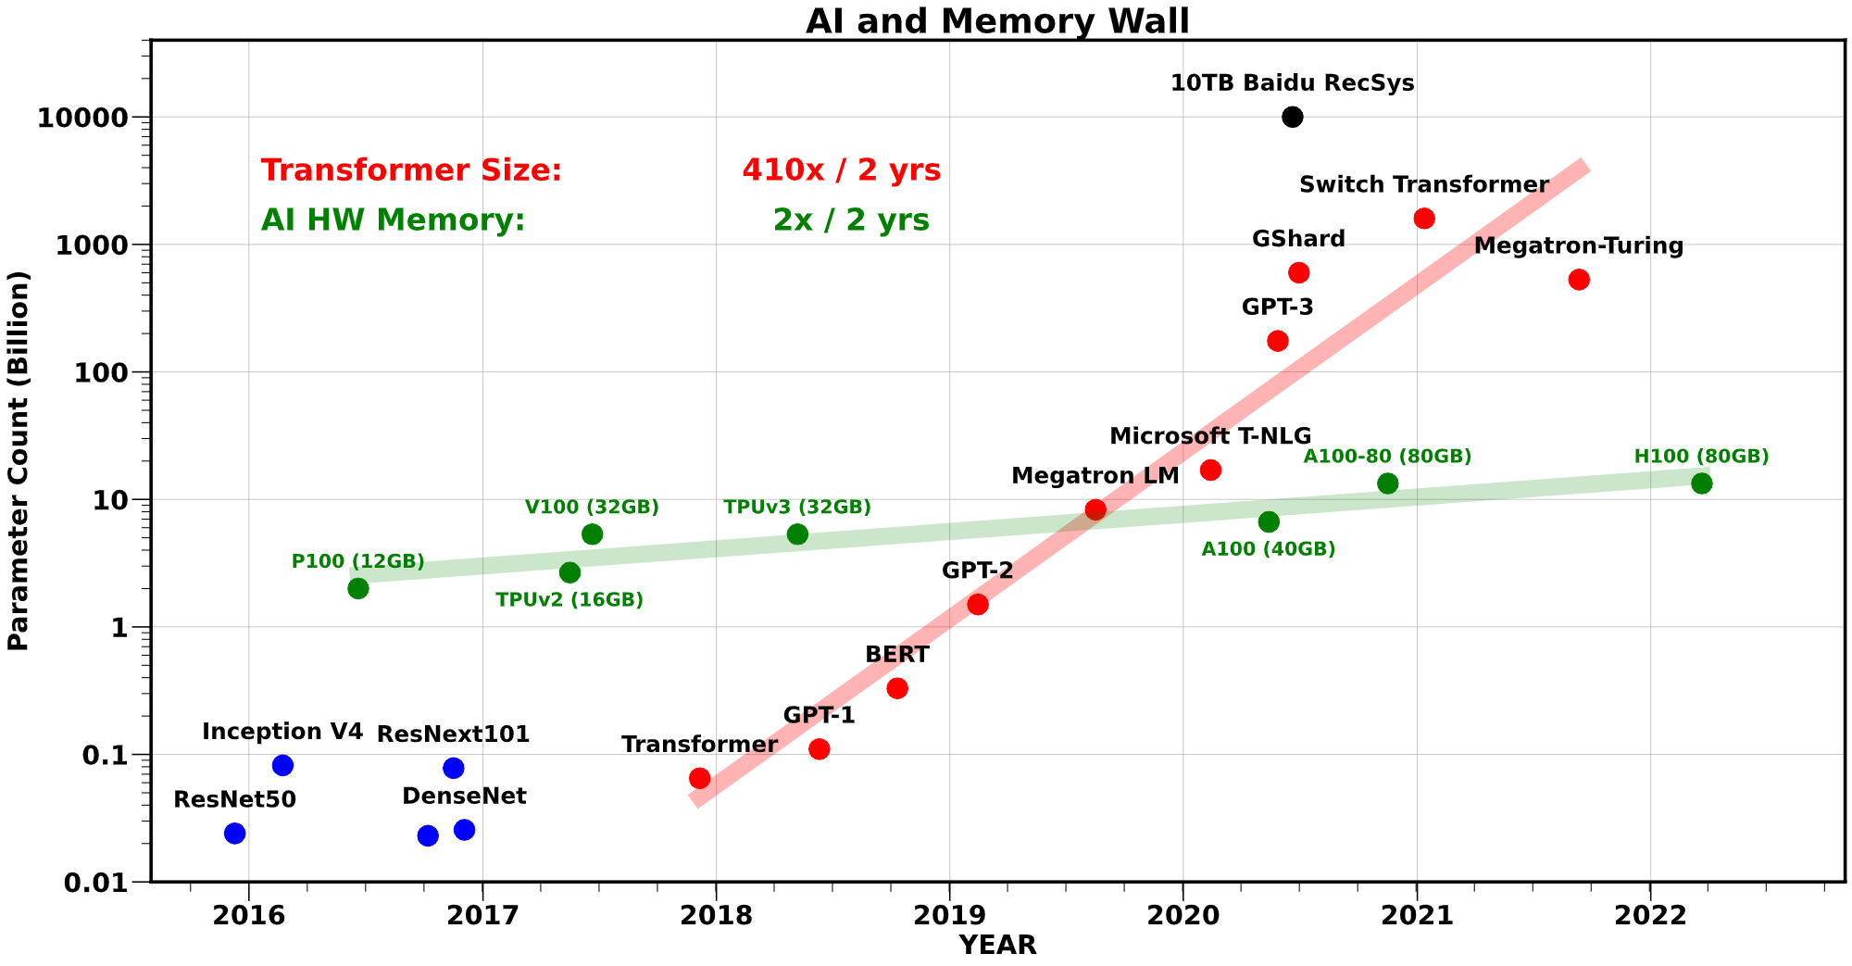
Memory & Generative AI (II)
Increasing gap
Gholami A, Yao Z, Kim S, Mahoney MW, Keutzer K. AI and Memory Wall. RiseLab Medium Blog Post, University of Califonia Berkeley, 2021, March 29.

Slide 6




Memory Isolation
A memory access should not have unintended side effects on data stored in other addresses
A fundamental property for robustness (safety, security, and reliability)
Data loss or corruption
access
Compromise application correctness
1 → 0
Leak private information
Take over a computer
Memory
Memory isolation is difficult in modern memory chips
Notes:
Let’s start with the concept of memory isolation, a fundamental primitive for system security and privacy [CLICK]
Imagine that you access a memory location, and a bitflip occurs in some other location [CLICK]
We would not want this to happen because it can lead to data loss or corruption [CLICK]
Compromise application correctness [CLICK]
It can be used to leak private information [CLICK]
Or even to take over a computer [CLICK]
Therefore, we have this principle called memory isolation dictating that a memory access should not have unintended side effects on data stored in other addresses. This is important for memory integrity [CLICK]
Unfortunately, it is difficult in modern memory chips and here is why [CLICK]

Slide 7
Read Disturbance in Modern Memory Chips
Prevalent memory technology: Dynamic Random Access Memory (DRAM)
DRAM stores data in the form of electrical charge on a capacitor
DRAM leaks charge over time and needs periodic refresh
DRAM Read Disturbance: Accessing a DRAM cell disturbs other physically nearby cells and exacerbates their charge leakage
Wordline
Bitline
Charge
leakage
paths
Notes:
Dynamic random access memory (DRAM) is the prevalent memory technology today. [CLICK]
DRAM stores a bit of data in the form of electrical charge on a capacitor [CLICK]
To access we assert a wire called wordline [CLICK]
Which enables a transistor, conducting the capacitor to another wire called bitline [CLICK]
DRAM is a volatile memory technology as it leaks charge over time and needs to be periodically refreshed [CLICK]
Accessing a DRAM cell disturbs other physically nearby cells and exacerbates their charge leakage. This is called DRAM read disturbance [CLICK]

Slide 8
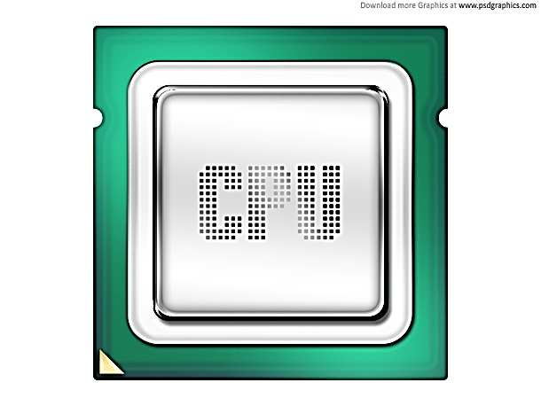
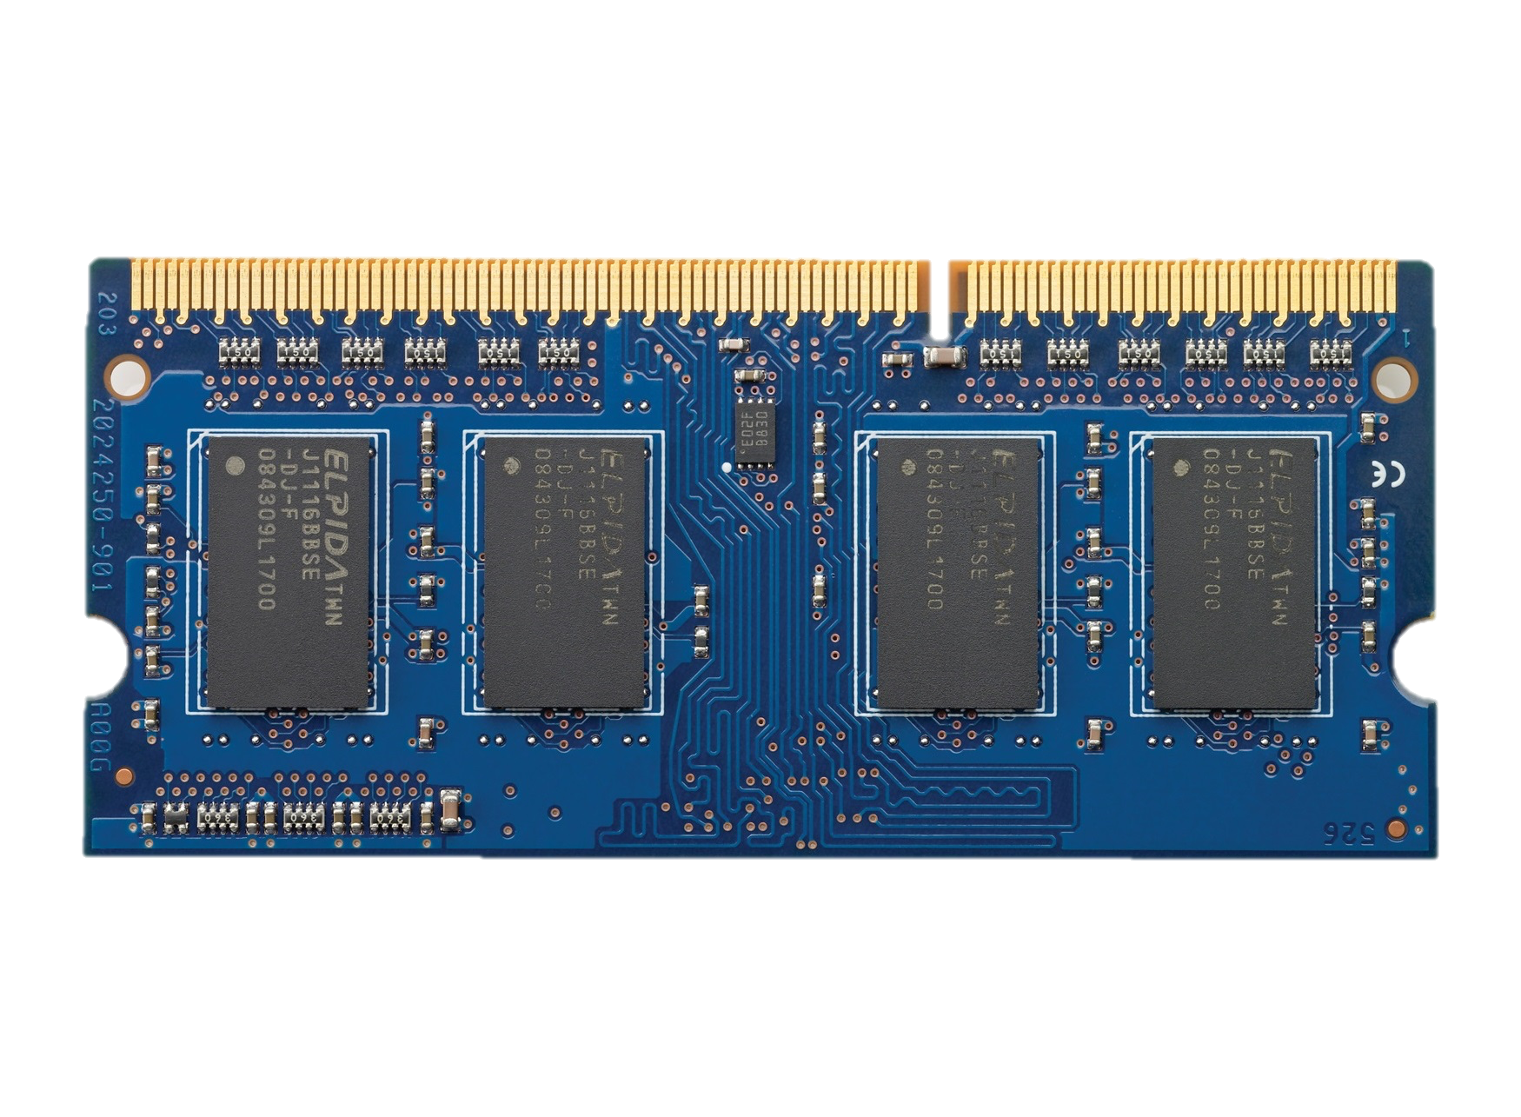
High-Level DRAM Organization
DRAM chips
DRAM
Channel
DRAM Module

Slide 9
DRAM Chip Internals
DRAM Cell
Bitline
DRAM Array
Wordline
Bank
S
S
S
S
Sense amplifiers
(row buffer)

Slide 10
RowHammer: An Example of DRAM Read Disturbance
DRAM Subarray
Row 0
Row 1
Row 1
Victim Row
Row 2
Row 2
Row 2
Row 2
Row 2
Row 2
open
open
open
closed
closed
Aggressor Row
Aggressor Row
Row 3
Row 3
Row 2
Victim Row
closed
Row 4
Repeatedly opening (activating) and closing (precharging)
a DRAM row causes RowHammer bitflips in nearby cells
and breaks memory isolation
Notes:
A prime example of DRAM read disturbance is RowHammer, which I will show in this slide.
DRAM cells are organized in 2 dimensional arrays as rows and columns and internally accessed in a DRAM row granularity. For example, to access a data stored in Row 2, [CLICK]
We first need to open Row 2, and then perform accesses. Once we need to access another row, we need to close Row 2 and open the other row [CLICK]
[BACK& FORTH] If we keep opening and closing this row many times, called hammering a row, [CLICK]
We observe bitflips in physically nearby DRAM rows [CLICK]
This phenomenon is called RowHammer. We refer to the hammered row as the aggressor row and the rows that are affected as victim rows. [CLICK]

Slide 11
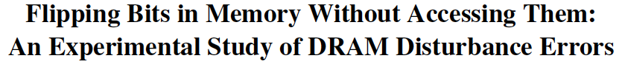
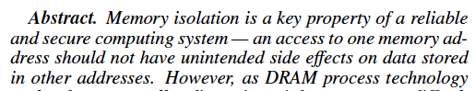
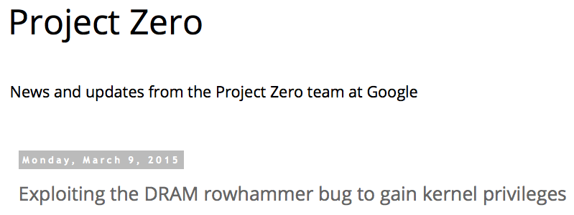
One Can Take Over an Otherwise-Secure System
Flipping Bits in Memory Without Accessing Them: An Experimental Study of DRAM Disturbance Errors (Kim et al., ISCA 2014)
Exploiting the DRAM rowhammer bug to gain kernel privileges (Seaborn, 2015)
Induce bit flips in page table entries (PTEs).
Gain write access to its own page table, and hence gain read-write access to all of physical memory.

Slide 12
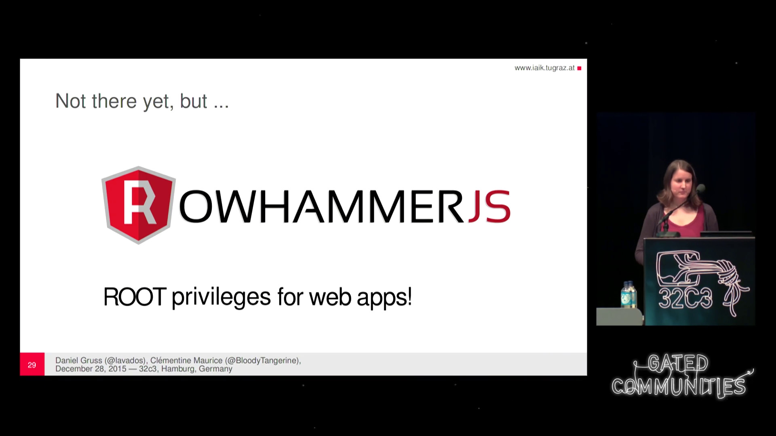
More Security Implications (I)
“We can gain unrestricted access to systems of website visitors.”
Rowhammer.js: A Remote Software-Induced Fault Attack in JavaScript (DIMVA’16)
Source: https://lab.dsst.io/32c3-slides/7197.html

Slide 13

More Security Implications (II)
“Can gain control of a smart phone deterministically”
Drammer: Deterministic Rowhammer Attacks on Mobile Platforms, CCS’16
Source: https://fossbytes.com/drammer-rowhammer-attack-android-root-devices/

Slide 14
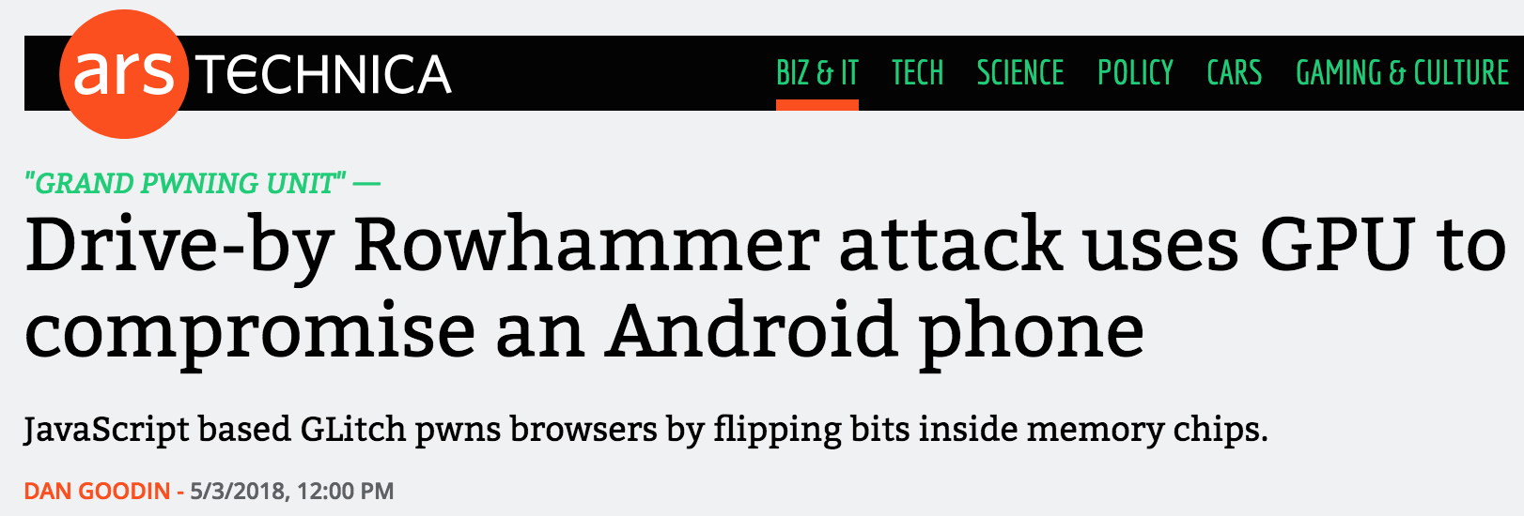

More Security Implications (III)
Using an integrated GPU in a mobile system to remotely escalate privilege via the WebGL interface. IEEE S&P 2018

Slide 15
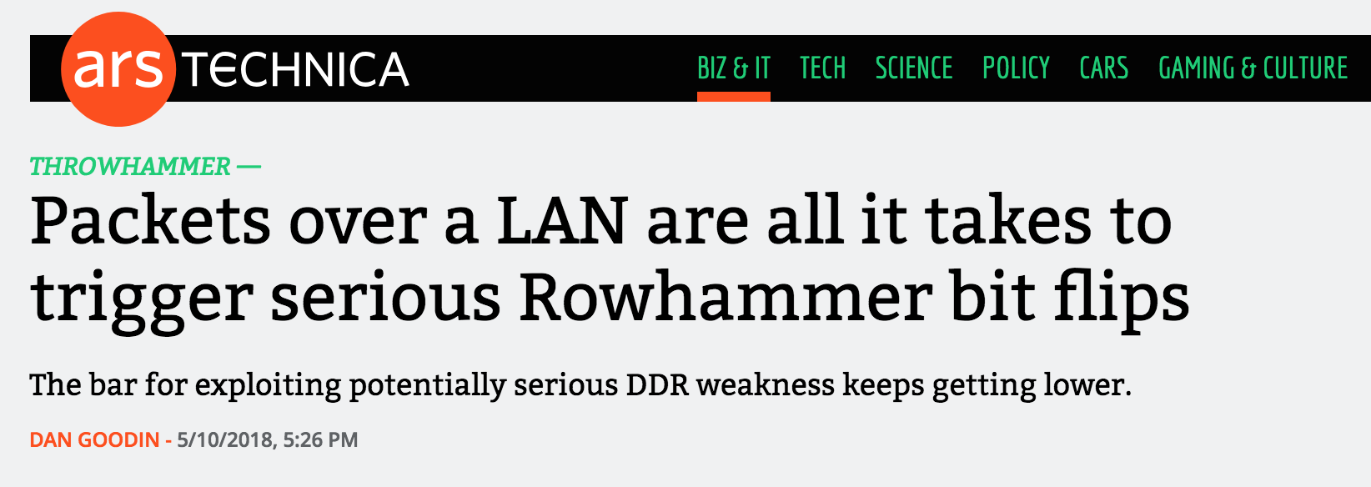
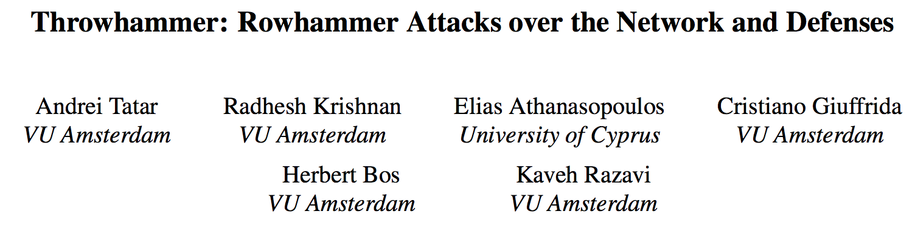
More Security Implications (IV)
Rowhammer over RDMA (I)
[Tatar+ USENIX ATC, 2018]

Slide 16



More Security Implications (V)
Rowhammer over RDMA (II)
[Lipp+ EuroS&PW, 2020]

Slide 17
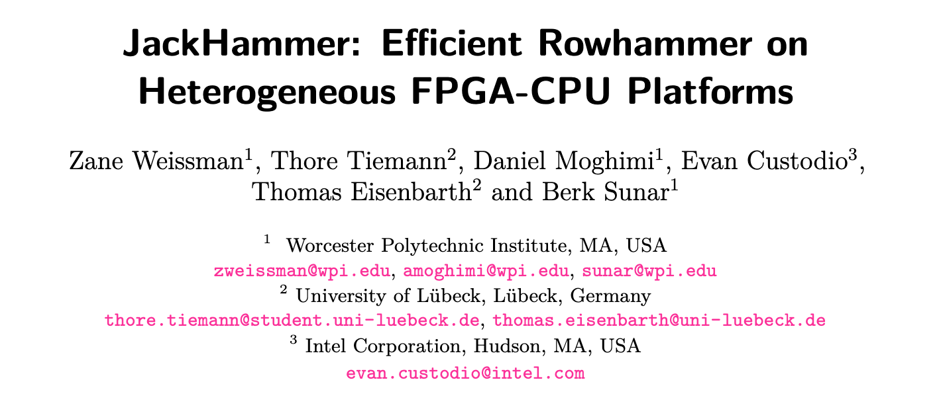
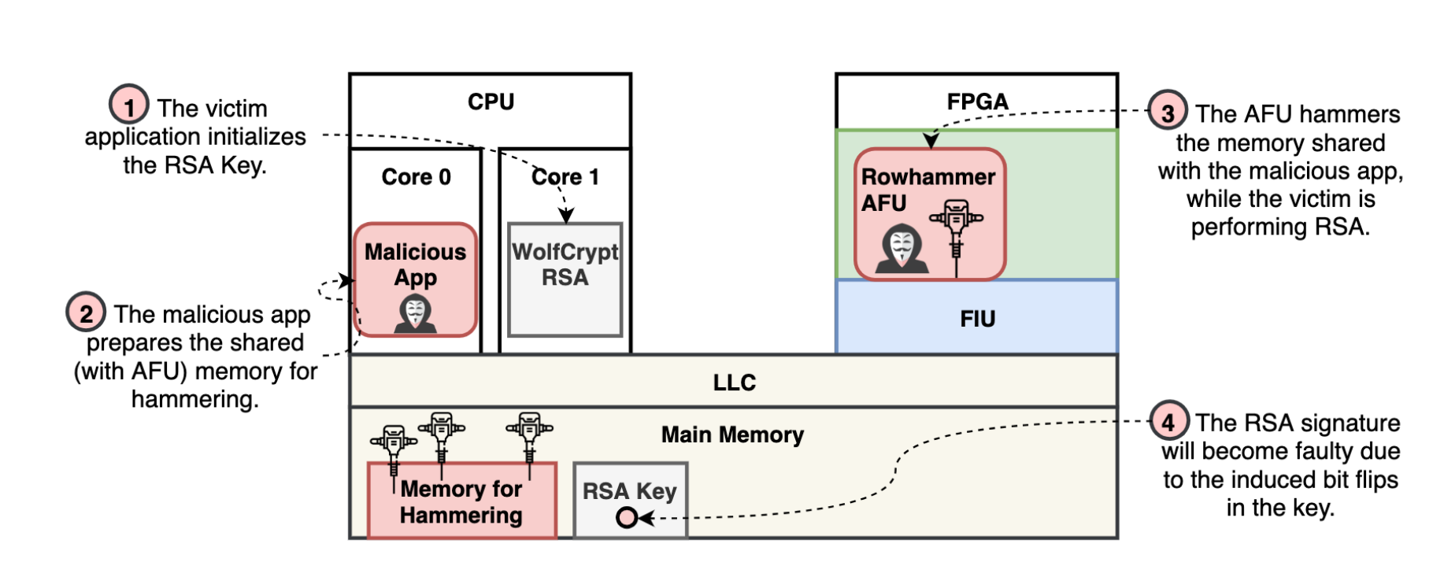
More Security Implications (VI)
An FPGA-based RowHammer attack recovering private keys twice as fast compared to CPU-based attacks
[Weissman+ CHES 2020]

Slide 18

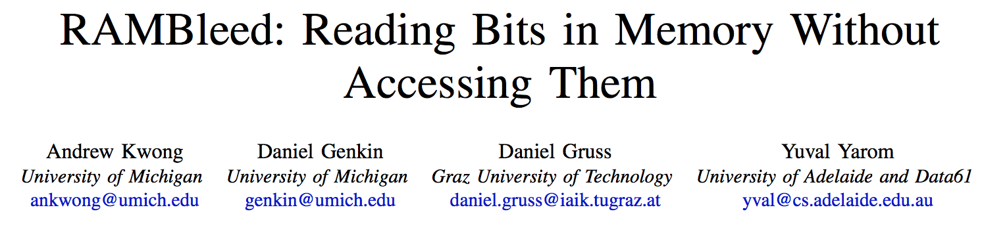
More Security Implications (VII)
[Kwong+ IEEE S&P 2020]

Slide 19
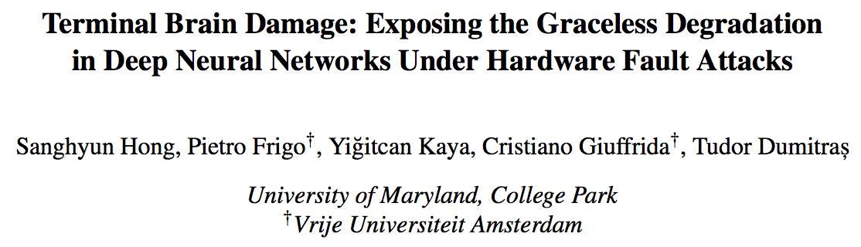
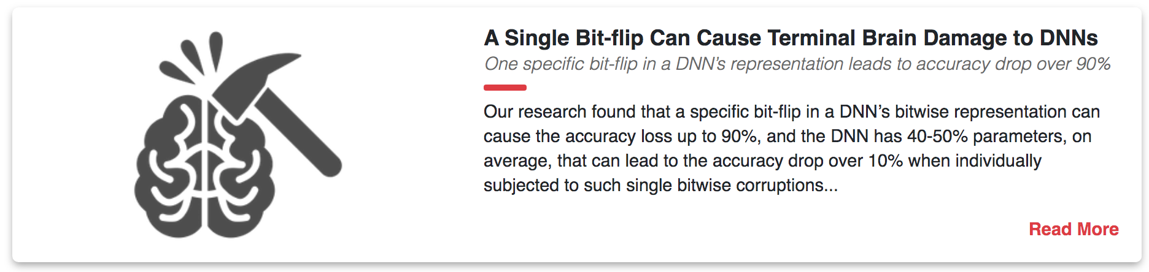
More Security Implications (VIII)
[Hong+ USENIX Security 2019]

Slide 20
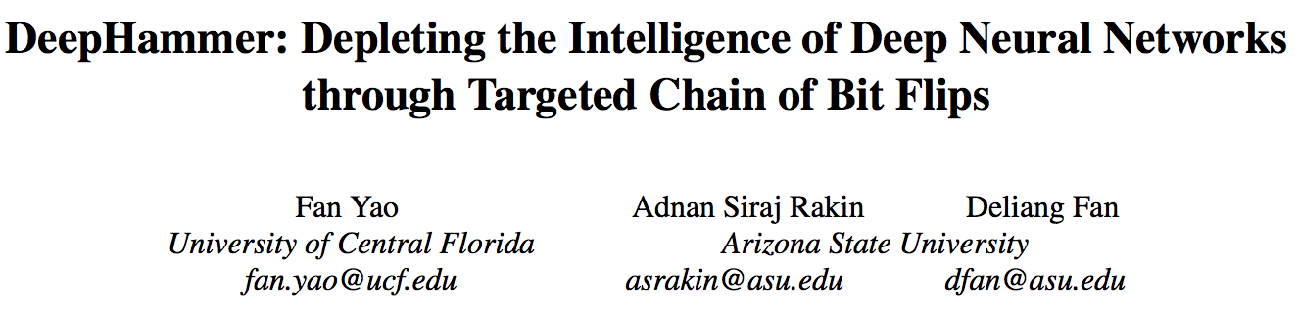
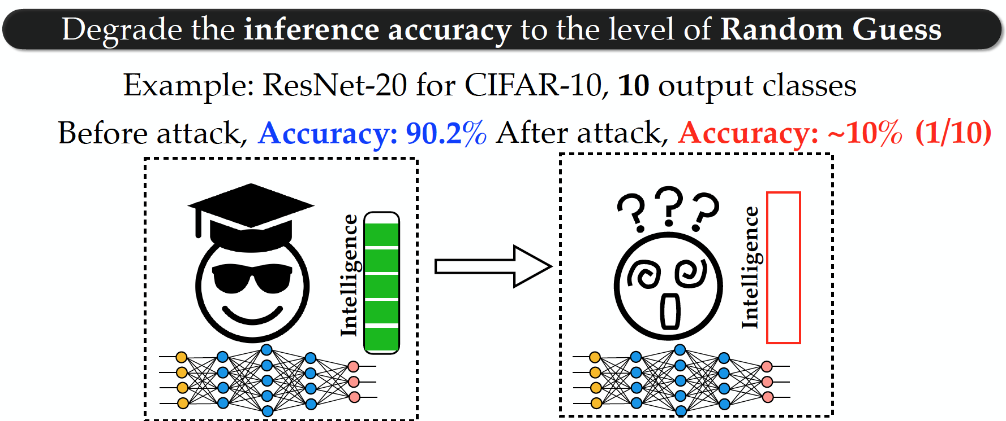
More Security Implications (IX)
[Yao+ USENIX Security 2020]

Slide 21
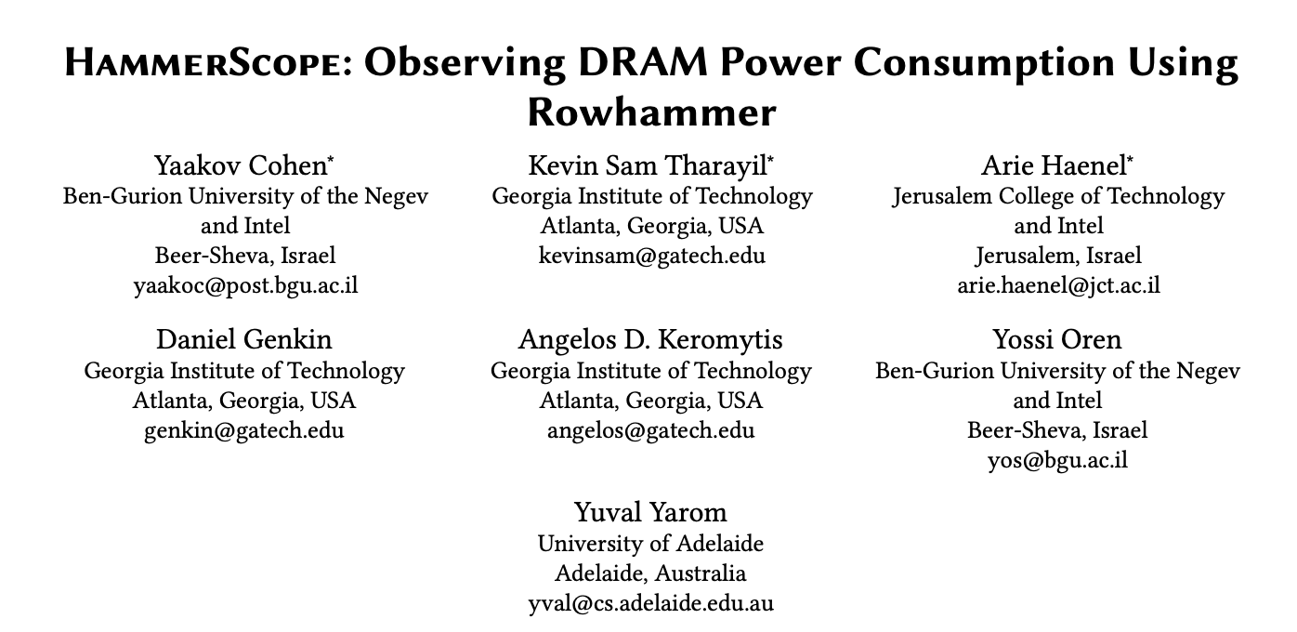
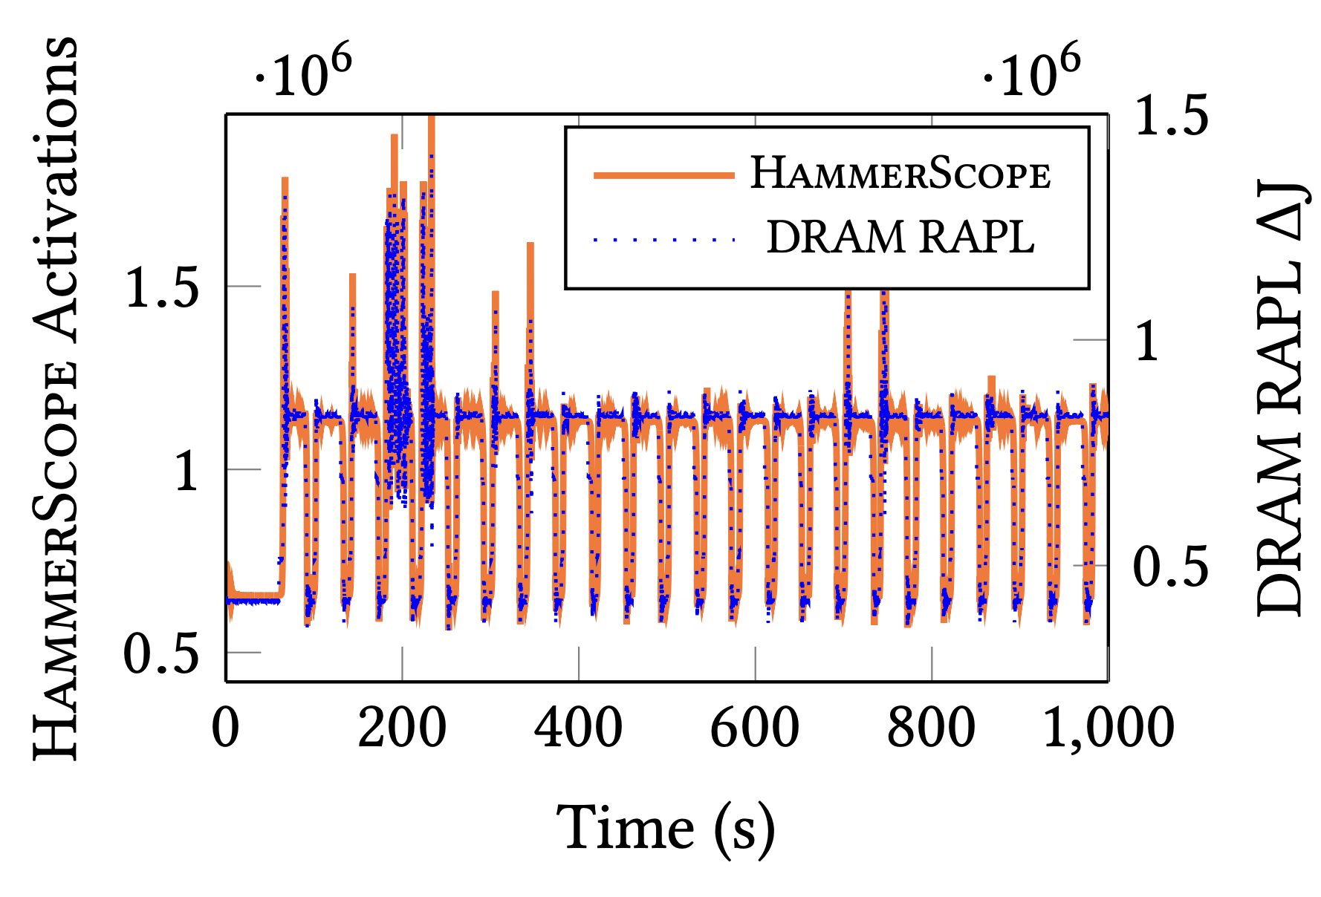
More Security Implications (X)
HammerScope is a software-based power analysis method using RowHammer as a side channel
[Cohen+ CCS 2022]

Slide 22
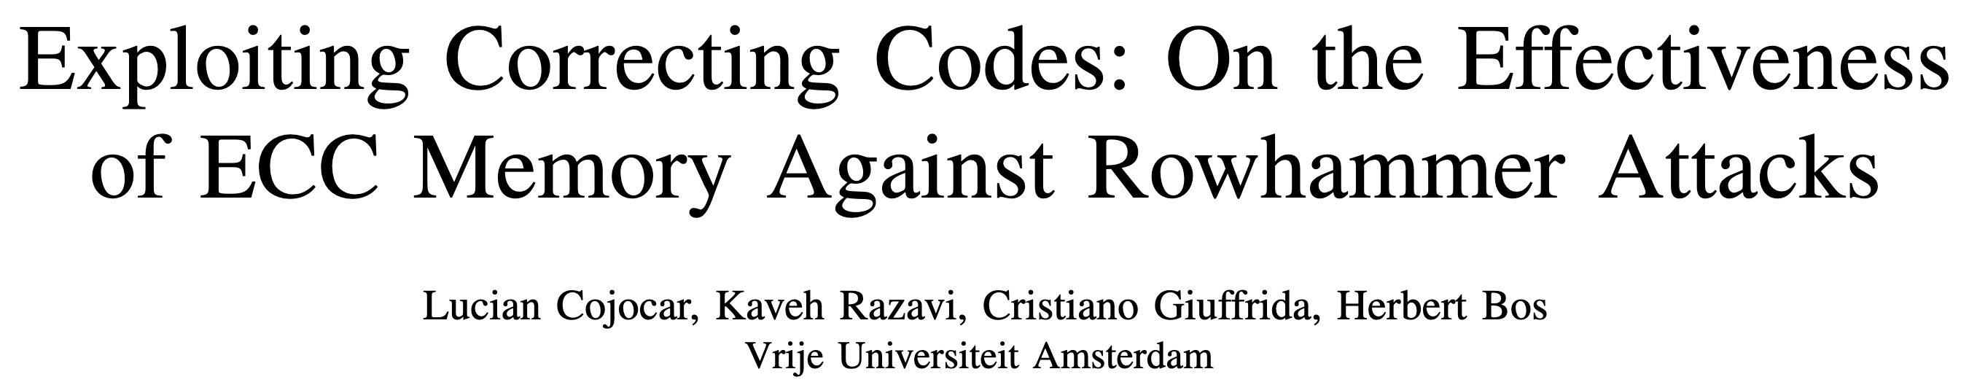
More Security Implications (XI)
Exploiting Correcting Codes: On the Effectiveness of ECC Memory Against Rowhammer Attacks. Cojocar, L. .; Razavi, K.; Giuffrida, C.; and Bos, H. In S&P, May 2019 Best Practical Paper Award, Pwnie Award Nomination for Most Innovative Research [Paper] [Slides]
Thus, many believed that Rowhammer on ECC memory, even if plausible in theory, is simply impractical. This paper shows this to be false: while harder, Rowhammer attacks are still a realistic threat even to modern ECC-equipped systems.

Slide 23
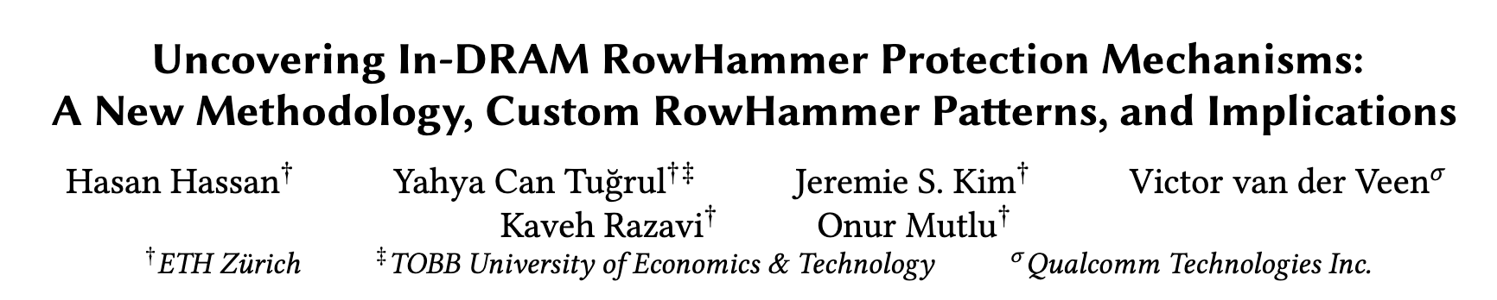





More Security Implications (XII)
Hasan Hassan, Yahya Can Tugrul, Jeremie S. Kim, Victor van der Veen, Kaveh Razavi, and Onur Mutlu, "Uncovering In-DRAM RowHammer Protection Mechanisms: A New Methodology, Custom RowHammer Patterns, and Implications,” MICRO, 2021. [Slides (pptx) (pdf)] [Short Talk Slides (pptx) (pdf)] [Lightning Talk Slides (pptx) (pdf)] [Full Talk (25 mins)] [Lightning Talk (1.5 mins)]
15x Vendor A DDR4 modules
All 45 modules we test are vulnerable
15x Vendor B DDR4 modules
99.9% of rows in a DRAM bank experience at least one RowHammer bit flip
New RowHammer access patterns
15x Vendor C DDR4 modules
U-TRR
Up to 7 RowHammer bitflips in an 8-byte dataword, making ECC ineffective
TRR does not provide security against RowHammer
U-TRR can facilitate the development of new RowHammer attacks and more secure RowHammer protection mechanisms
Notes:
[CLICK] The RowHammer vulnerability of modern DRAM is a critical reliability and security threat.
[CLICK] The security guarantees of TRR, which is the commonly used RowHammer protection mechanism, cannot be easily studied as TRR is obscure, undocumented, and proprietary.
[CLICK] In this work, our main goal is to answer the following questions. Is TRR fully secure? How can we validate the security guarantees of different TRR mechanisms?
[CLICK] To this end, we propose U-TRR, a new methodology that leverages data retention failures in DRAM to uncover the inner workings of TRR and study its security.
[CLICK] Using U-TRR, we analyze 15 DDR4 DRAM modules from each of the three major DRAM vendors.
[CLICK] Through these analyses, we make several observations regarding the TRR mechanisms implemented in these modules and craft new custom RowHammer access patterns that cause RowHammer bit flips in TRR-protected DRAM modules.
[CLICK] Our results show that: First, all 45 modules that we test across three vendors are vulnerable to our new RowHammer access patterns.
[CLICK] Second, our access pattern cause at least one bit flip in almost all DRAM rows in many modules. This makes system-level RowHammer attacks easier to mount as the attacker would have the ability to cause bit flips in almost any DRAM row [CLICK] Third, we observe that our access patterns cause up to 7 RowHammer bit flips in an 8-byte dataword, making ECC ineffective and systems equipped with ECC also susceptible to RowHammer attacks
[CLICK] We conclude that TRR does not provide security against RowHammer and can be easily circumvented using the new understanding provided by U-TRR.
[CLICK] We believe and hope that U-TRR will facilitate future research by enabling rigorous and open analysis of RowHammer mitigation mechanisms, leading to the development of both new RowHammer attacks and more secure RowHammer protection mechanisms.

Slide 24

A RowHammer Survey:
Onur Mutlu, Ataberk Olgun, and A. Giray Yaglikci, "Fundamentally Understanding and Solving RowHammer” Invited Special Session Paper at the 28th Asia and South Pacific Design Automation Conference (ASP-DAC), Tokyo, Japan, January 2023. [arXiv version] [Slides (pptx) (pdf)] [Talk Video (26 minutes)]
https://arxiv.org/pdf/2211.07613.pdf

Slide 25
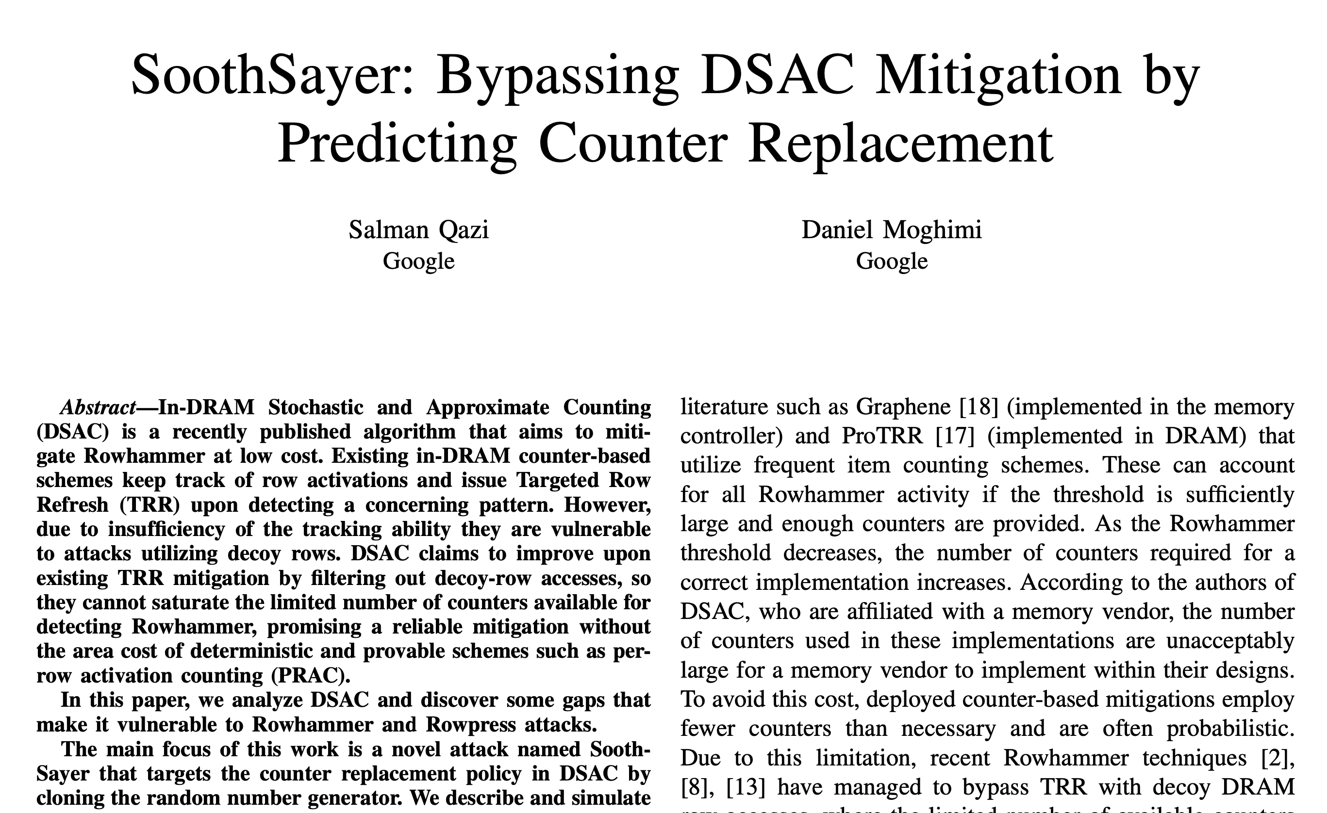
Breaking Samsung’s Best Practice
Salman Qazi and Daniel Moghimi, “SoothSayer: Bypassing DSAC Mitigation by Predicting Counter Replacement,” DRAMSec, 2024

Slide 26
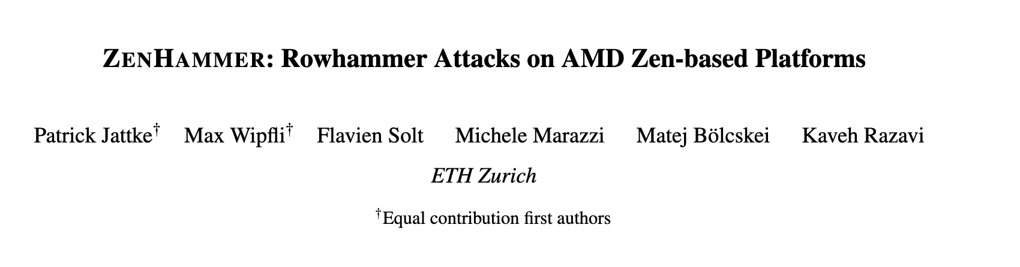
RowHammer in DDR5
Patrick Jattke; Max Wipfli; Flavien Solt; Michele Marazzi; Matej Bölcskei; and Kaveh Razavi, “ZenHammer: Rowhammer Attacks on AMD Zen-based Platforms,” in USENIX Security, 2024. [Paper] [URL]
We found bit flips on only 1 of 10 tested devices (S1), suggesting that the changes in DDR5 such as improved Rowhammer mitigations, on-die error correction code (ECC), and a higher refresh rate (32 ms) make it harder to trigger bit flips.

Slide 27
DRAM Read Disturbance: A Critical Challenge
Technology node scaling
[Kim+, ISCA’14]
[Kim+, ISCA’20]
[Luo+, ISCA’23]
DRAM cells become increasingly more vulnerable to read disturbance
Notes:
With technology node scaling, DRAM cells get smaller in size and closer to each other[CLICK]
Such that we observe significant reductions in the minimum hammer count to induce the first bitflip in the last decade [CLICK]
Thus DRAM cells become increasingly more vulnerable to read disturbance [CLICK]

Slide 28
Existing RowHammer Mitigations (I)
DRAM Subarray
Row 0
Row 0
Row 0
Victim Row
Row 1
Row 1
Row 1
Row 1
Victim Row
Row 2
Row 2
Row 2
Row 2
Row 2
Row 2
open
open
open
closed
Aggressor Row
Aggressor Row
Row 3
Row 3
Row 3
Row 3
Victim Row
Row 4
Row 4
Row 4
Victim Row
Refreshing potential victim rows mitigates read disturbance bitflips

Slide 29

Existing RowHammer Mitigations (II)
DRAM Subarray
Row 0
Row 0
Row 0
Victim Row
Row 1
Row 1
Row 1
Row 1
Victim Row
Row 2
Row 2
Row 2
Row 2
Row 2
Row 2
open
open
open
closed
Aggressor Row
Aggressor Row
Row 3
Row 3
Row 3
Row 3
Victim Row
Row 4
Row 4
Row 4
Victim Row
Mitigation techniques track DRAM row activation counts (of aggressor rows) to preventively refresh potential victim rows

Slide 30


Existing RowHammer Mitigations (III) Overview of Preventive Refresh-Based Mitigation Techniques
DRAM
Processor Chip
Processor Chip
Processor Chip
Shared Counters
Row A
Counter A
Tag A
Counter A
Tag A
Counter A
Row B
Counter B
Tag B
Counter B
Tag B
Counter B
Row C
Counter C
Tag C
Counter C
Row D
Counter D
CAM-based implementation
One ACT counter
per DRAM row
One ACT counter per aggressor row
<1 counter per DRAM row
VERY LOW
LOW
HIGH
Performance & Energy Costs
Many DRAM rows
(e.g., 128K per bank)
High DRAM bandwidth consumption
# of aggressor rows
increases significantly
Area Cost
VERY HIGH
HIGH
LOW

Slide 31
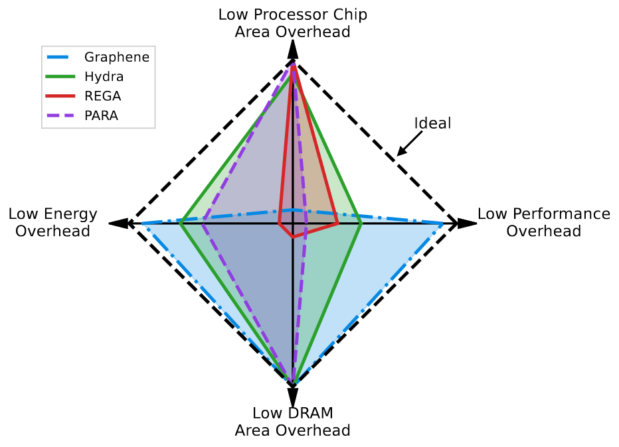
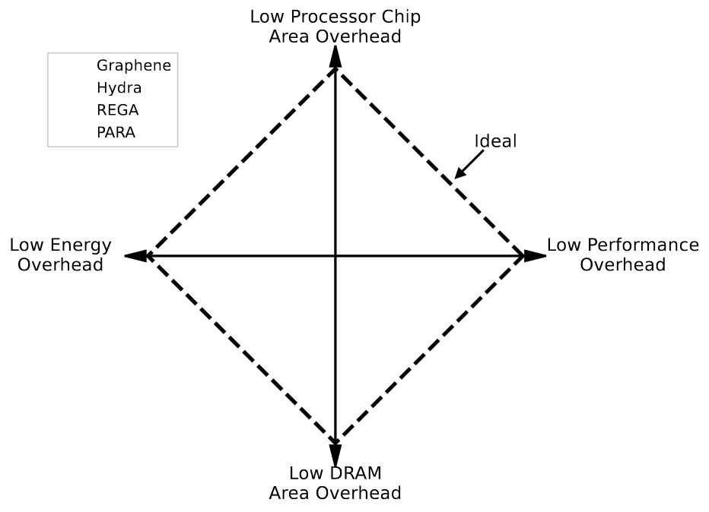
Existing RowHammer Mitigations (IV) Overhead Trade-Off of State-of-the-Art Mitigation Techniques
Notes:
Ideally, we would like to achieve low energy, processor chip and DRAM area and performance overheads
[CLICK]
As you can see from this radar chart

Slide 32
Existing RowHammer Mitigations (IV) Overhead Trade-Off of State-of-the-Art Mitigation Techniques
No existing mitigation technique prevents RowHammer bitflips at low area, performance and energy costs
Notes:
None of the existing mitigation techniques prevents RowHammer at low area performance and energy costs

Slide 33
Our Goal
Prevent RowHammer bitflips with low area, performance, and energy overheads in highly vulnerable DRAM-based systems
(e.g., a RowHammer threshold of 125)

Slide 34
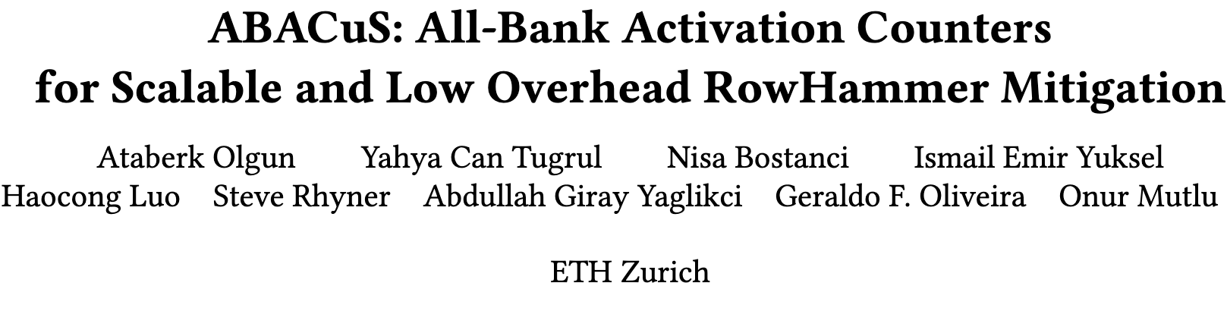
ABACuS: All-Bank Activation Counters
Ataberk Olgun, Yahya Can Tugrul, Nisa Bostanci, Ismail Emir Yuksel, Haocong Luo, Steve Rhyner, Abdullah Giray Yaglikci, Geraldo F. Oliveira, and Onur Mutlu, "ABACuS: All-Bank Activation Counters for Scalable and Low Overhead RowHammer Mitigation” To appear in Proceedings of the 33rd USENIX Security Symposium (USENIX Security), Philadelphia, PA, USA, August 2024. [arXiv version] [ABACuS Source Code]

Slide 35
ABACuS All-Bank Activation Counters for Scalable and Low Overhead RowHammer Mitigation
will be presented next week in USENIX Security 2024
Ataberk Olgun
Yahya Can Tuğrul
F. Nisa Bostancı
İsmail Emir Yüksel
Haocong Luo
Steve Rhyner
A. Giray Yağlıkçı
Geraldo F. Oliveira
Onur Mutlu
35

Slide 36
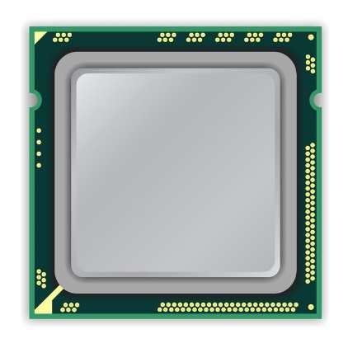
Key Observation
Many workloads access the same row address in different banks at around the same time
CPU
Bank 0
Bank 1
Row X
Row X
Bank 2
Bank 3
LD (3,X)
Row X
Row X
LD (3,Y)
LD (0,X)
LD (1,X)
LD (2,X)
Load request targeting bank 0 row X
Sibling rows
Time
LD (0,X)
LD (1,X)
LD (3,Y)
LD (3,X)
LD (2,X)
36
Notes:
Many workloads access the same row address in different banks at around the same time. We will show what we observe over an example.

Slide 37
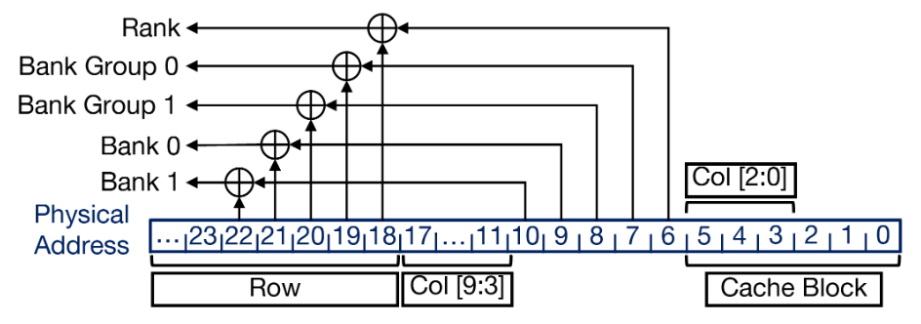
Explanation for the Key Observation
1
Programs exhibit spatial locality: access cache blocks around each other at around the same time
2
Address mappings distribute consecutive cache blocks to different banks to leverage bank-level parallelism (using the same row ID)
37
Notes:
32-bank system
Window of 128 row activations
Shows the numbe rof different banks accessed in each window

Slide 38
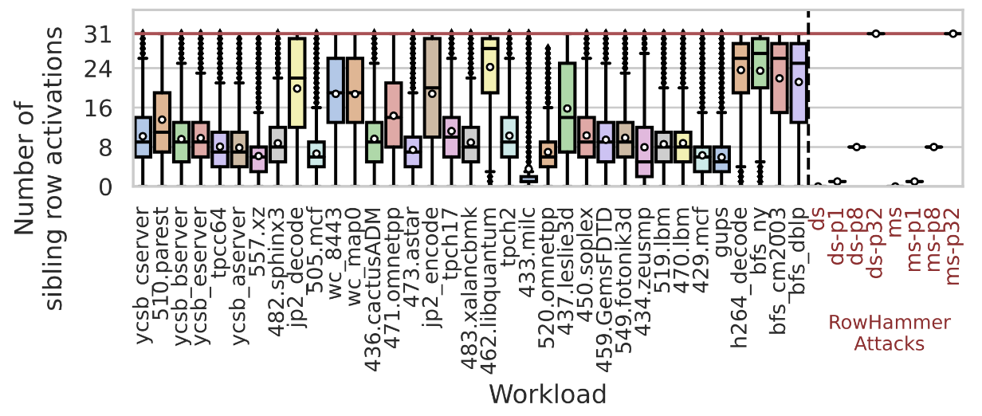
Motivational Analysis
Gathered from 128 row activation windows in a 32-bank system
Workloads access the same row address in different DRAM banks at around the same time
38
Notes:
32-bank system
Window of 128 row activations
Shows the numbe rof different banks accessed in each window

Slide 39
Problem
No mitigation mechanism leverages
the spatial locality across banks
Area overhead linearly increases
with the number of banks

Slide 40
Key Idea
Sibling rows can share one activation counter
to reduce the number of counters
by a factor of the bank count
Bank 0
Bank 1
…
Bank 15
Bank 0-15
…
Counter X
Counter X
…
Counter X
Counter X
Existing Row Activation Tracker
ABACuS-Based Tracker
16x reduction in number of counters
Sibling rows: Rows with the same ID across all banks

Slide 41
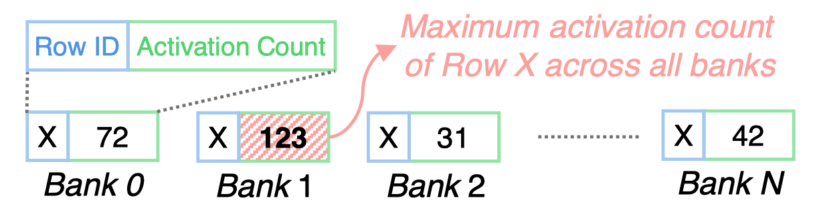
ABACuS: High-level Overview
Key Mechanism: Track the maximum (worst) activation count of sibling rows using one counter
41

Slide 42
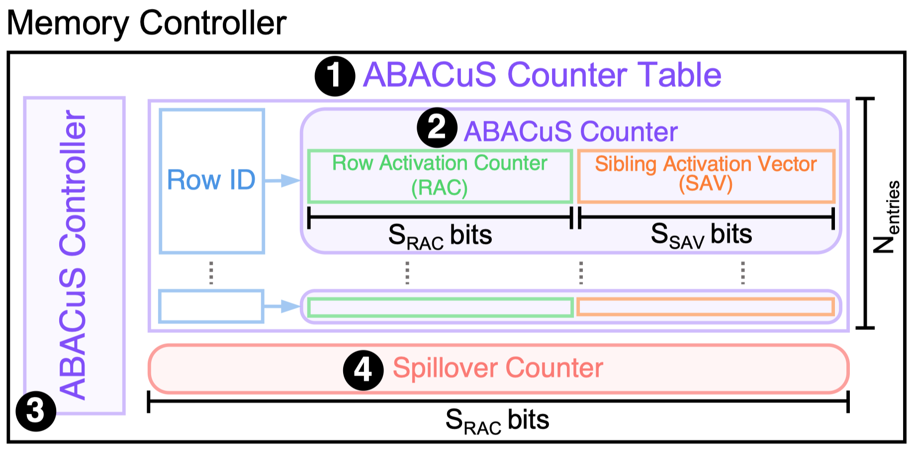
ABACuS’s Integration with Misra-Gries Algorithm (I)
42
Notes:
Need to describe misra gries as something secondary and not very fundamental

Slide 43
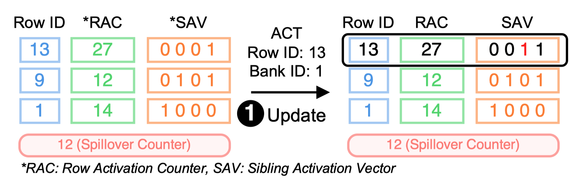
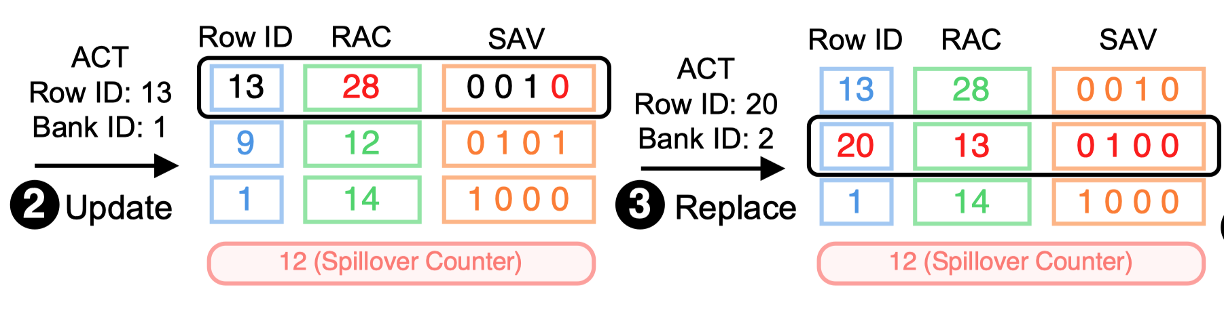
ABACuS’s Integration with Misra-Gries Algorithm (II)
secure
ABACuS does not underestimate but can overestimate
a DRAM row’s activation count
potential
performance
overhead
43

Slide 44
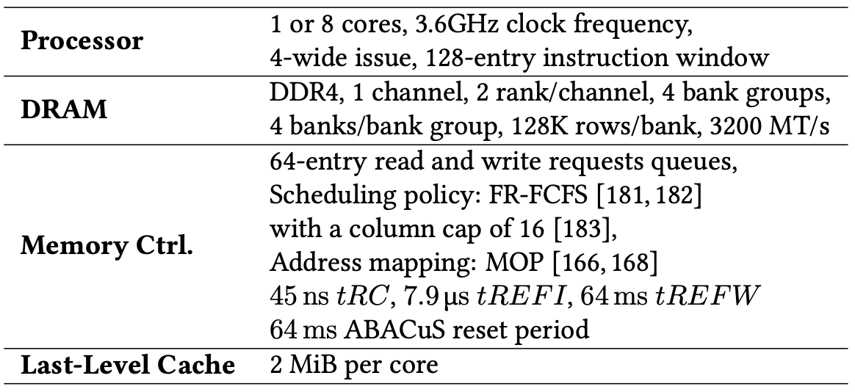
Evaluation
System Configuration
Workloads: 62 1- & 8-core workloads
Four different very low nRH values: 1000, 500, 250, 125
Four state-of-the-art mitigation mechanisms
44

Slide 45
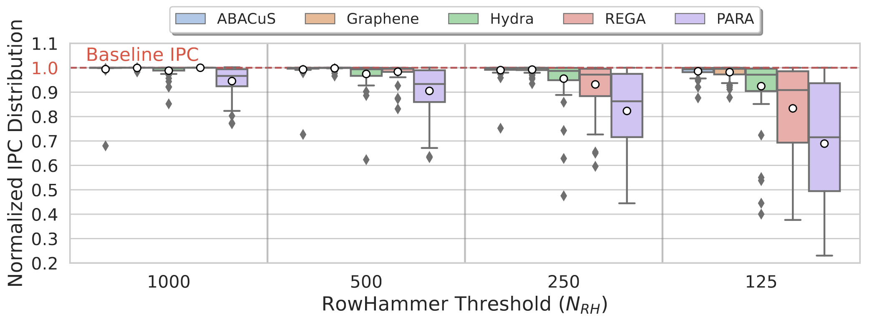
Performance Comparison
Lower overhead than all evaluated state-of-the-art mechanisms (except Graphene)
45

Slide 46
More in the Paper
More motivational analysis
Multi-core performance & energy results
Performance under adversarial workloads
Alternative ABACuS design
Performance & energy sensitivity to:
Blast radius
Number of ABACuS counters
Number of banks
Circuit area, latency, energy, and power
Security proof
46

Slide 47
ABACuS Summary
Goal: Prevent RowHammer bitflips at low performance, energy, and area cost especially at very low RowHammer thresholds (e.g., 125 aggressor row activations induce a bitflip)
Key Observation: Many workloads access the same row address in different DRAM banks at around the same time
Key Idea: Use one counter to track the activation count of many rows with the same address across all DRAM banks
Key Results: At very low RowHammer thresholds, ABACuS:
Induces small system performance and DRAM energy overhead
Outperforms the state-of-the-art mitigation (Hydra)
Takes up 22.7X smaller chip area than state-of-the-art (Graphene)
https://github.com/CMU-SAFARI/ABACuS
47

Slide 48
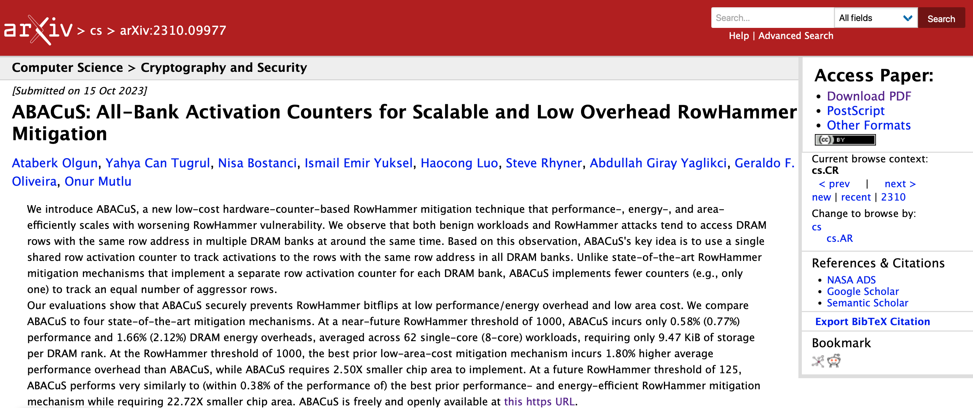
Extended Version on arXiv
https://arxiv.org/pdf/2310.09977.pdf
48

Slide 49
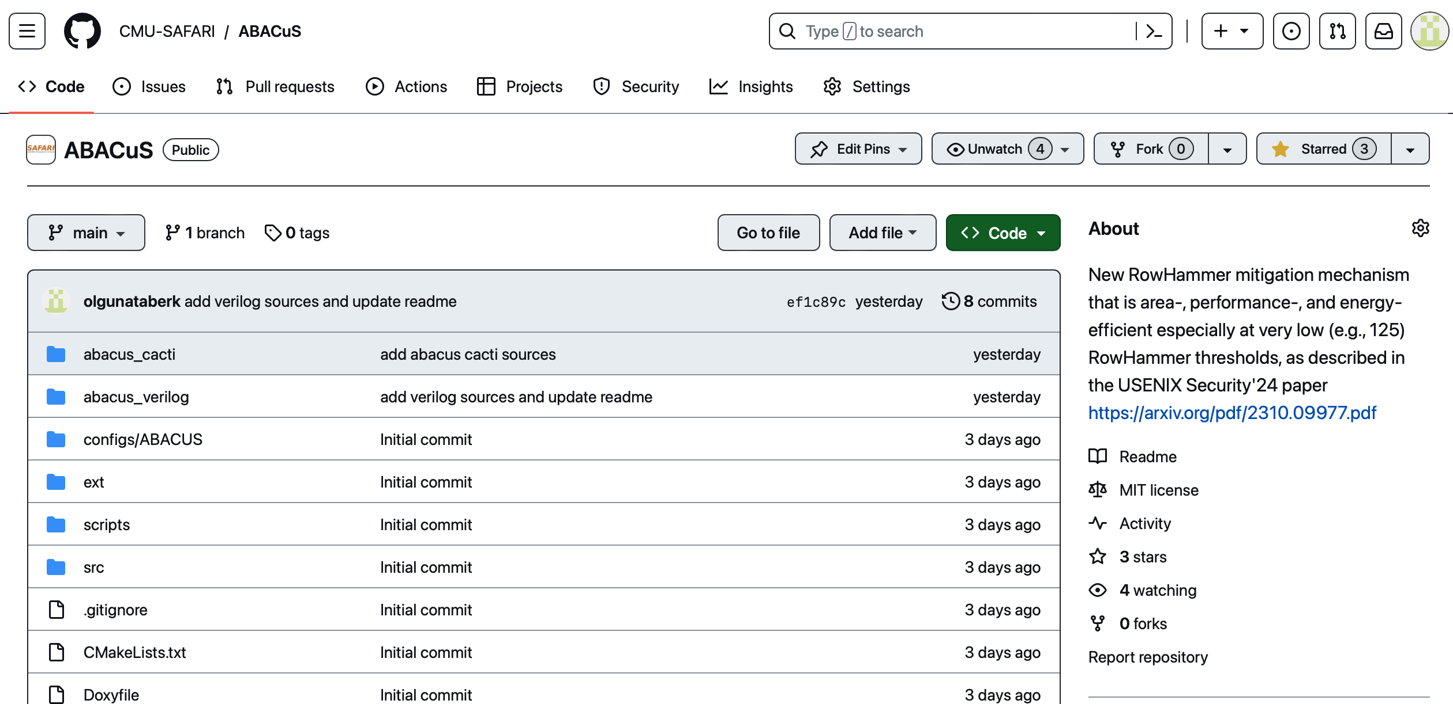
ABACuS is Open Source
https://github.com/CMU-SAFARI/ABACuS
49

Slide 50
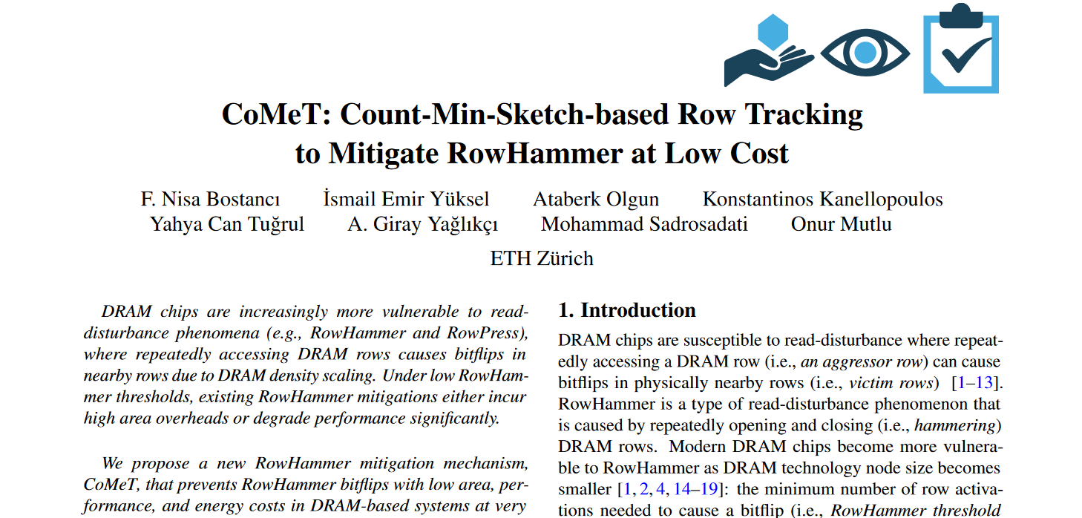
CoMeT: Count-Min-Sketch-based Row Tracking
F. Nisa Bostanci, Ismail Emir Yuksel, Ataberk Olgun, Konstantinos Kanellopoulos, Yahya Can Tugrul, A. Giray Yaglikci, Mohammad Sadrosadati, and Onur Mutlu, "CoMeT: Count-Min-Sketch-based Row Tracking to Mitigate RowHammer at Low Cost” Proceedings of the 30th International Symposium on High-Performance Computer Architecture (HPCA), April 2024. [Slides (pptx) (pdf)] [arXiv version] [CoMeT Source Code (Officially Artifact Evaluated with All Badges)] Officially artifact evaluated as available, reviewed and reproducible.

Slide 51



CoMeT Count-Min-Sketch-based Row Tracking to Mitigate RowHammer at Low Cost
HPCA 2024
F. Nisa Bostancı
I. E. Yüksel A. Olgun K. Kanellopoulos Y. C. Tuğrul
A. G. Yağlıkçı M. Sadrosadati O. Mutlu
https://github.com/CMU-SAFARI/CoMeT

Slide 52
Key Observation
Hash-based counters are low-cost:
can be implemented with low-cost structures and
can aggregate many rows' activation counts together
LOW COST
DRAM
1
Hash Function
(Example)
Counters
Row 0
Row 0
2
Row 1
0
1
2
3
Row 2
H(ID) = ID % 4
Row 3
Row 4
Row 4
Mapping without tags
Fixed number of counters
Tag-based counters are highly accurate:
Each one tracks one row's activation count
Tag
Counter
Row 0
Row 0
HIGH ACCURACY
…
Notes:
We observe that there are two types of counters
[CLICK]Hash based counters are low cost
[CLICK]And tag based counters are highly accurate
We want to get the best of both worlds
Now let me explain how these work

Slide 53
Key Idea
1
Use low-cost and scalable hash-based counters to track most DRAM rows' activations with low area overhead
2
Use highly accurate tag-based counters to track only a small set of DRAM rows to achieve low performance overhead

Slide 54
CoMeT Overview
Counter Table (CT):
Maps each DRAM row to a group of low-cost hash-based counters as uniquely as possible by employing the Count-Min Sketch technique
Triggers a preventive refresh to an aggressor row's victim rows when the aggressor's counter group reaches an activation threshold
Tracks DRAM row activations at low area cost
Recent Aggressor Table (RAT):
Allocates highly accurate per-DRAM-row counters for only a small set of DRAM rows that are activated many times
Reduces performance penalties by increasing tracking accuracy

Slide 55
More Operational Details for CoMeT
ACT A
CoMeT
1
2
Counter Table
Recent Aggressor Table
Hash-based Counters
Tag-based Counters
Counter Table-Based Estimation
Recent Aggressor Table-Based
Estimation
used when there is a row ID match
3
ESTIMATION
ACT_Count(A) == N_{PR}
preventive refresh threshold
https://arxiv.org/abs/2402.18769
Preventively Refresh
A's victim rows
https://github.com/CMU-SAFARI/CoMeT

Slide 56
Hardware Complexity
Storage and area overhead analysis: CACTI
Dual-rank area overhead comparison:
0.89
4.89
5.4×
74.2×
Significantly less area overhead
CoMeT stores fewer bits as the RowHammer threshold decreases
Similar area overheads
CoMeT incurs a significantly less area overhead than Graphene and a similar area overhead to Hydra

Slide 57
Evaluation Methodology
Performance and energy consumption evaluation: cycle-level simulations using Ramulator [Kim+, CAL 2015] and DRAMPower [Chandrasekar+, DATE 2013]
System Configuration:
Processor 1 or 8 cores, 3.6GHz clock frequency,
4-wide issue, 128-entry instruction window
DRAM DDR4, 1 channel, 2 rank/channel, 4 bank groups,
4 banks/bank group, 128K rows/bank
Memory Ctrl. 64-entry read and write requests queues,
Scheduling policy: FR-FCFS with a column cap of 16 Last-Level Cache 8 MiB (single-core), 16 MiB (8-core)
CoMeT Counter Table: 4 hash functions 512 counters per hash Recent Aggressor Table: 128 entries
Comparison Points: 4 state-of-the-art RowHammer mitigations
Graphene (best performing), Hydra (area-optimized best performing), Low Processor Chip Area Cost: REGA, PARA
Workloads: 61 single-core applications and 56 8-core workload mixes
SPEC CPU2006, SPEC CPU2017, TPC, MediaBench, YCSB
https://github.com/CMU-SAFARI/CoMeT

Slide 58
Performance and DRAM Energy
Average performance and DRAM energy overheads of CoMeT across single-core applications
4.01%
2.07%
CoMeT prevents bitflips with very small average performance and DRAM energy overheads compared to a baseline system with no RowHammer mitigation
Notes:
We evaluate the average performance and DRAM energy overheads of CoMeT across single core applications
[CLICK] This is CoMeT's performance normalized to a system with no RH mitigation across different RH thresholds [CLICK]
As RH threshold decreases CoMeT has a small performance overhead due to preventive refreshes as opposed to the baseline that does not do preventive refresh
[CLICK] This is CoMeT's DRAM energy consumption normalized to the same baseline [CLICK] and it shows a similar result
[CLICK] We conclude that CoMeT prevents bitflips with very small average performance ….

Slide 59
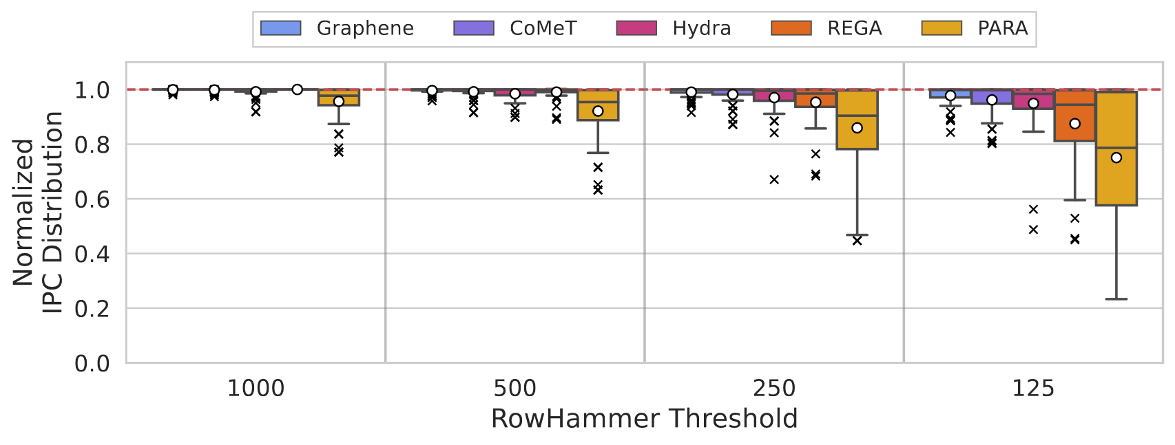
Performance Comparison: Single-Core Applications
1.75%
1.75%
CoMeT outperforms all low-area-cost mitigations starting from the RowHammer threshold of 500
(average)
CoMeT incurs a small performance overhead (≤ 1.75%) over Graphene and outperforms Hydra (by up to 39.1%) at all RowHammer thresholds

Slide 60
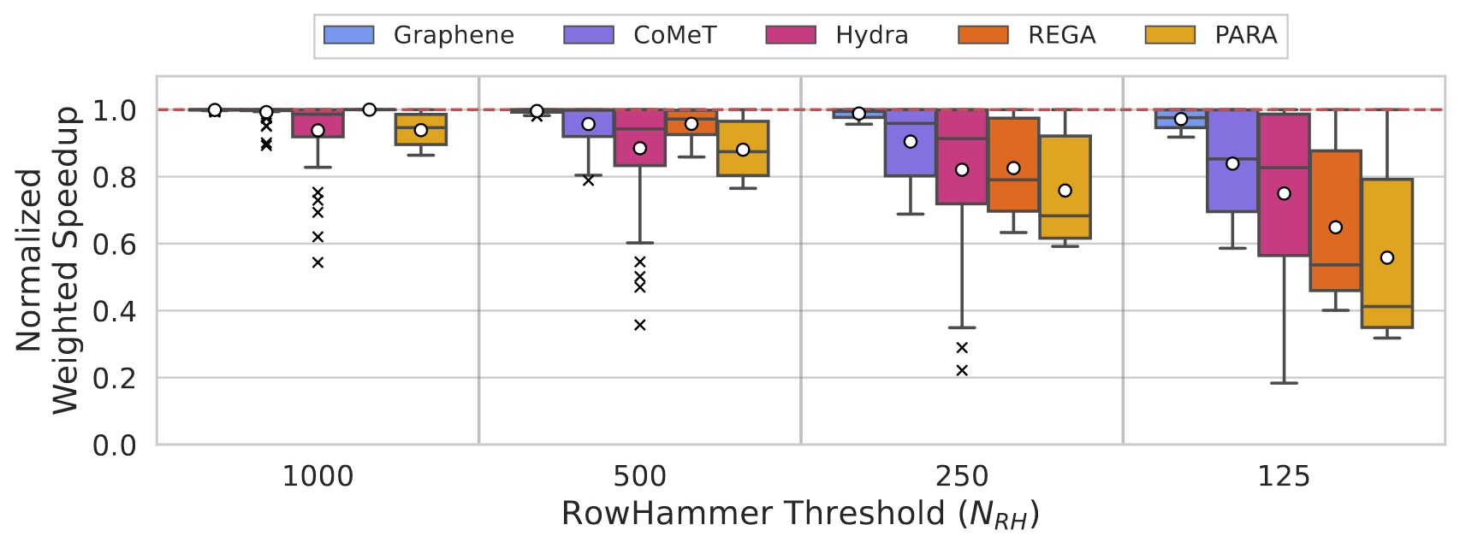
Performance Comparison: 8-Core Workloads
Trends are similar to single-core application evaluation trends

Slide 61
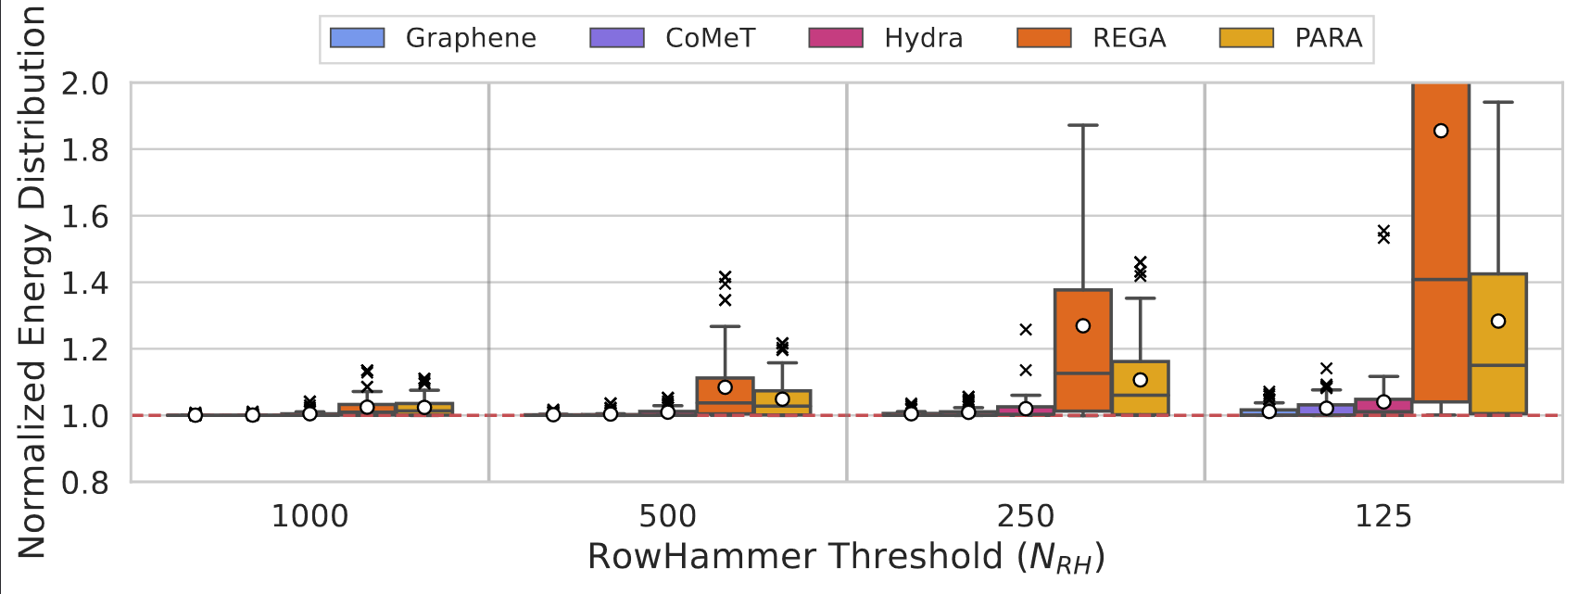
DRAM Energy Comparison: Single-Core Applications
CoMeT consumes less DRAM energy than all low-area-cost mitigations for all RowHammer thresholds
1.88%
0.39%
0.04%
0.96%
CoMeT incurs a small DRAM energy overhead (<1%) over Graphene and consumes less DRAM energy than Hydra

Slide 62
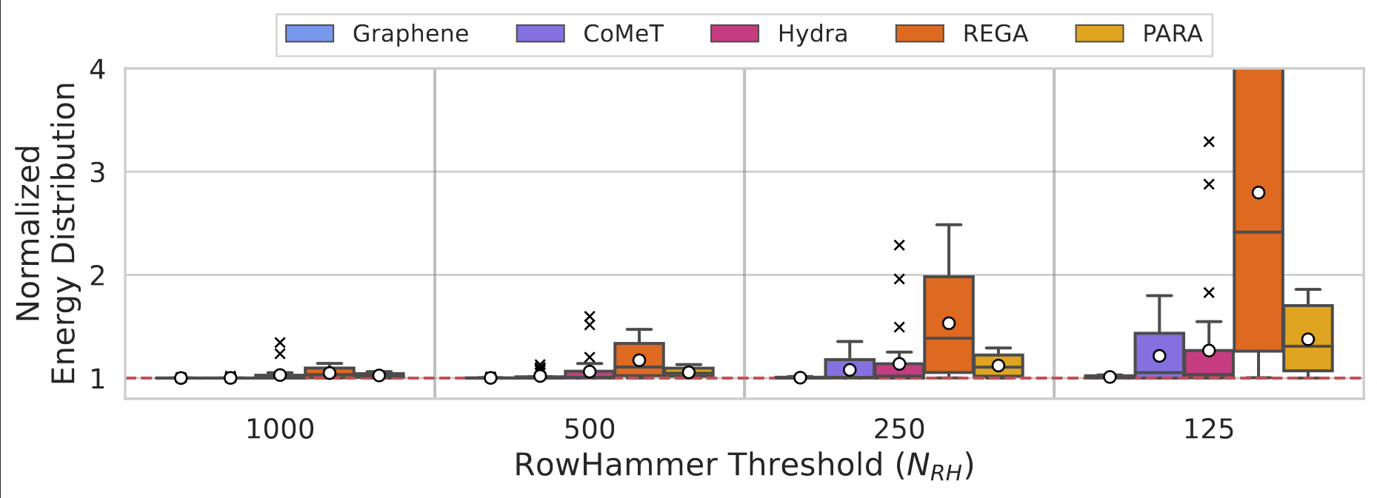
DRAM Energy Comparison: 8-Core Workloads
Multicore energy trends are similar to single core energy trends

Slide 63
More in the Paper
Security Analysis of CoMeT
Sensitivity Analysis
Counter Table Configurations
Recent Aggressor Table Configurations
Counter Reset Period and Preventive Refresh Threshold Values
CoMeT's Performance under Adversarial Workloads
Comparison against Throttling-Based Mitigation Techniques
CoMeT's Performance at High RowHammer Thresholds

Slide 64
More in the Paper
Security Analysis of CoMeT
Sensitivity Analysis
Counter Table Configurations
Recent Aggressor Table Configurations
Counter Reset Period and Preventive Refresh Threshold values
Performance Evaluation under Adversarial Workloads
Performance Evaluation Comparison against Throttling-Based Mitigation Techniques
Performance Evaluation at High RowHammer Thresholds
https://arxiv.org/abs/2402.18769

Slide 65
Conclusion
Goal: Prevent RowHammer bitflips with low area, performance, and energy overheads in highly RowHammer-vulnerable DRAM-based systems
Key Idea: Use low-cost and scalable hash-based counters to accurately track DRAM rows
CoMeT:
tracks most DRAM rows with scalable hash-based counters by employing the Count-Min-Sketch technique to achieve a low area cost
tracks only a small set of DRAM rows that are activated many times with highly accurate per-DRAM-row activation counters to reduce performance penalties
Evaluation: CoMeT achieves a good trade-off between area, performance and energy costs
incurs significantly less area overhead (74.2×) compared to the state-of-the-art technique
outperforms the state-of-the-art technique (by up to 39.1%)
https://github.com/CMU-SAFARI/CoMeT

Slide 66
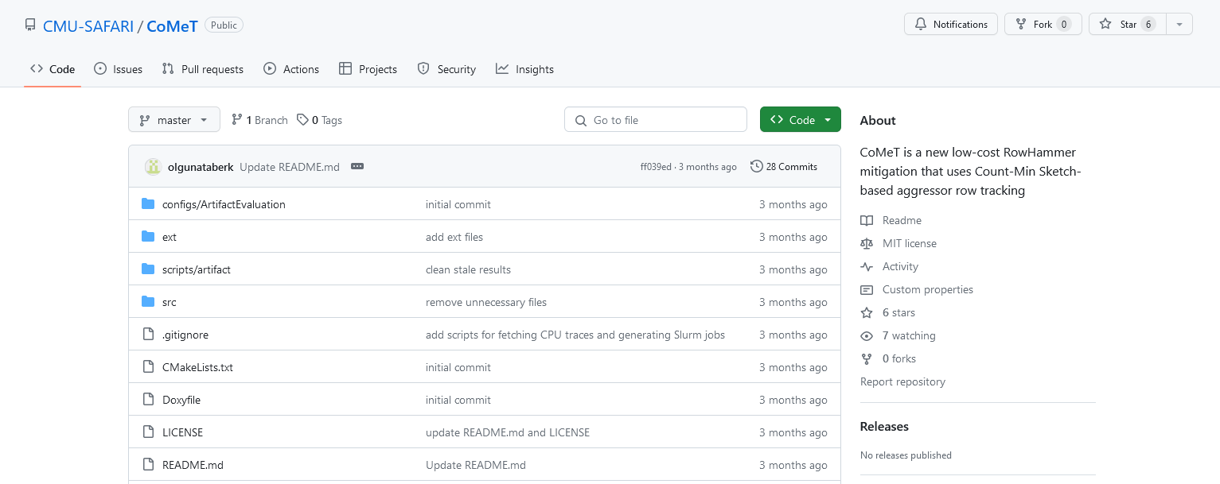
CoMeT is Open Source and Artifact Evaluated
https://github.com/CMU-SAFARI/CoMeT

Slide 67
Scalable and Low Overhead DRAM Read Disturbance Mitigation
Abdullah Giray Yağlıkçı
(on behalf of Ataberk Olgun)
The Future of Memory and Storage
August 6, 2024
Notes:
Hello everyone, welcome to my doctoral examination. Today, I will give a high-level overview of the work that I have done throughout my Ph.D.

Slide 68
Scalable and Low Overhead DRAM Read Disturbance Mitigation
Backup Slides
Abdullah Giray Yağlıkçı
(on behalf of Ataberk Olgun)
The Future of Memory and Storage
August 6, 2024
Notes:
Hello everyone, welcome to my doctoral examination. Today, I will give a high-level overview of the work that I have done throughout my Ph.D.

Slide 69
ABACuS All-Bank Activation Counters for Scalable and Low Overhead RowHammer Mitigation
Ataberk Olgun
Yahya Can Tuğrul
F. Nisa Bostancı
İsmail Emir Yüksel
Haocong Luo
Steve Rhyner
A. Giray Yağlıkçı
Geraldo F. Oliveira
Onur Mutlu

Slide 70
ABACuS Summary
Problem: As DRAM becomes more vulnerable to read disturbance, existing RowHammer mitigation techniques either prevent bitflips
at high area overheads or
with prohibitively large performance and energy overheads
Goal: Prevent RowHammer bitflips at low performance, energy, and area cost especially at very low RowHammer thresholds (e.g., 125 aggressor row activations induce a bitflip)
Key Observation: Many workloads access the same row address in different DRAM banks at around the same time
Key Idea: Use one counter to track the activation count of many rows with the same address across all DRAM banks
Key Results: At very low RowHammer thresholds, ABACuS:
Induces small system performance and DRAM energy overhead
Outperforms the state-of-the-art mitigation (Hydra)
Takes up 22.7X smaller chip area than state-of-the-art (Graphene)
https://github.com/CMU-SAFARI/ABACuS

Slide 71
Outline
1. Background & Motivation
2. ABACuS: Key Idea and Mechanism
3. Evaluation
4. Conclusion

Slide 72
Outline
1. Background & Motivation
2. ABACuS: Key Idea and Mechanism
3. Evaluation
4. Conclusion

Slide 73
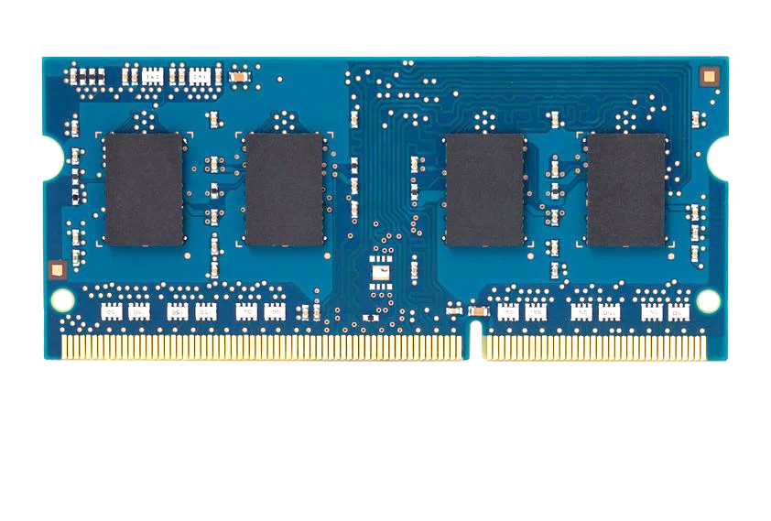
DRAM Read Disturbance (I)
DRAM Chip
CPU
DRAM Module
Notes:
This is a typical DRAM-based computing system with a CPU and a DRAM module
[CLICK] We will look at a simplified depiction of this DRAM chip to better understand the read disturbance vulnerability

Slide 74
DRAM Read Disturbance (II)
Read disturbance in DRAM breaks memory isolation
Prominent example: RowHammer
DRAM Chip
Row 1
Row 1
Row 1
Victim Row
Row 2
Row 2
Row 2
Row 2
Row 2
Row 2
open
open
Aggressor Row
closed
open
closed
Row 3
Row 3
Row 3
Victim Row
Repeatedly opening (activating) and closing a DRAM row many times causes RowHammer bitflips in adjacent rows
[Kim+, ISCA’14]
Notes:
Read disturbance has significant system-level implications because it breaks memory isolation.
[CLICK] A prominent example of read disturbance is RowHammer.
[CLICK] [CLICKx8] Repeatedly activating and closing a DRAM row many times causes RowHammer bitflips in adjacent rows
We call the repeatedly activated row the aggressor row and the rows that have bitflips victim rows

Slide 75
Read Disturbance Worsens
Read disturbance bitflips occur at much smaller activation counts
More than 100x decrease in less than a decade
139K
[Kim+, ISCA’14]
9.6K
[Kim+, ISCA’20]
<1K
[Luo+, ISCA’23]
Mitigation techniques against read disturbance attacks need to be effective and efficient for highly vulnerable systems
[Bostanci+, HPCA’24]

Slide 76
Read Disturbance Mitigation Approaches
There are many ways to mitigate RowHammer bitflips
More robust DRAM chips and/or error-correcting codes
Increased refresh rate
Physical isolation
Preventive refresh
Proactive throttling
Notes:
[CLICKx5] There are multiple ways to mitigate RowHammer bitflips each offering a different system
design point in the performance, energy, area tradeoff space
[CLICK] Preventive refresh-based ones are promising because of X and Y

Slide 77

Preventive Refresh
DRAM Chip
Row 1
Row 1
Row 1
Row 0
Victim Row
Row 2
Row 2
Row 2
Row 2
Row 2
Row 1
open
open
open
closed
Aggressor Row
Aggressor Row
Row 3
Row 3
Row 3
Row 2
Victim Row
Refreshing potential victim rows mitigates read disturbance bitflips
Requires aggressor row activation count estimation or tracking
[Kim+, ISCA’20]
Notes:
[CLICKx5] There are multiple ways to mitigate RowHammer bitflips each offering a different system
design point in the performance, energy, area tradeoff space
[CLICK] Preventive refresh-based ones are promising because of X and Y

Slide 78
Preventive-Refresh-Based Mitigations
DRAM
Processor Chip
Processor Chip
Processor Chip
Shared Counters
Row A
Counter A
Tag A
Counter A
Tag A
Counter A
Row B
Counter B
Tag B
Counter B
Tag B
Counter B
Row C
Counter C
Tag C
Counter C
Row D
Counter D
CAM-based implementation
One ACT counter
per DRAM row
One ACT counter per aggressor row
<1 counter per DRAM row
VERY LOW
LOW
HIGH
Performance & Energy Costs
Many DRAM rows
(e.g., >1M)
# of aggressor rows
increases significantly
High DRAM bandwidth consumption
Area Cost
VERY HIGH
HIGH
LOW
[Bostanci+, HPCA’24]
Notes:
If we look at how prior works estimate or track the activation count of DRAM rows, we see three main design choices

Slide 79
Problem & Goal
Problem
No existing mitigation technique prevents RowHammer bitflips at low area, performance and energy costs
Goal
Prevent RowHammer bitflips at low performance, energy, and area cost especially at very low RowHammer thresholds (e.g., 125 aggressor row activations induce a bitflip)

Slide 80
Outline
1. Background & Motivation
2. ABACuS: Key Idea and Mechanism
3. Evaluation
4. Conclusion

Slide 81
Key Observation
Many workloads access the same row address in different banks at around the same time
CPU
Bank 0
Bank 1
Row X
Row X
Bank 2
Bank 3
LD (3,X)
Row X
Row X
LD (3,Y)
LD (0,X)
LD (1,X)
LD (2,X)
Load request targeting bank 0 row X
Sibling rows
Time
LD (0,X)
LD (1,X)
LD (3,Y)
LD (3,X)
LD (2,X)
Notes:
Many workloads access the same row address in different banks at around the same time. We will show what we observe over an example.

Slide 82
Explanation for the Key Observation
1
Spatial locality in memory accesses
A program tends to access neighboring cache blocks at around the same time
e.g., a streaming access to an array
2
Modern physical → DRAM address mappings
Place neighboring cache blocks into different banks, but into the same row
Leverage DRAM bank-level parallelism for higher-throughput DRAM access

Slide 83
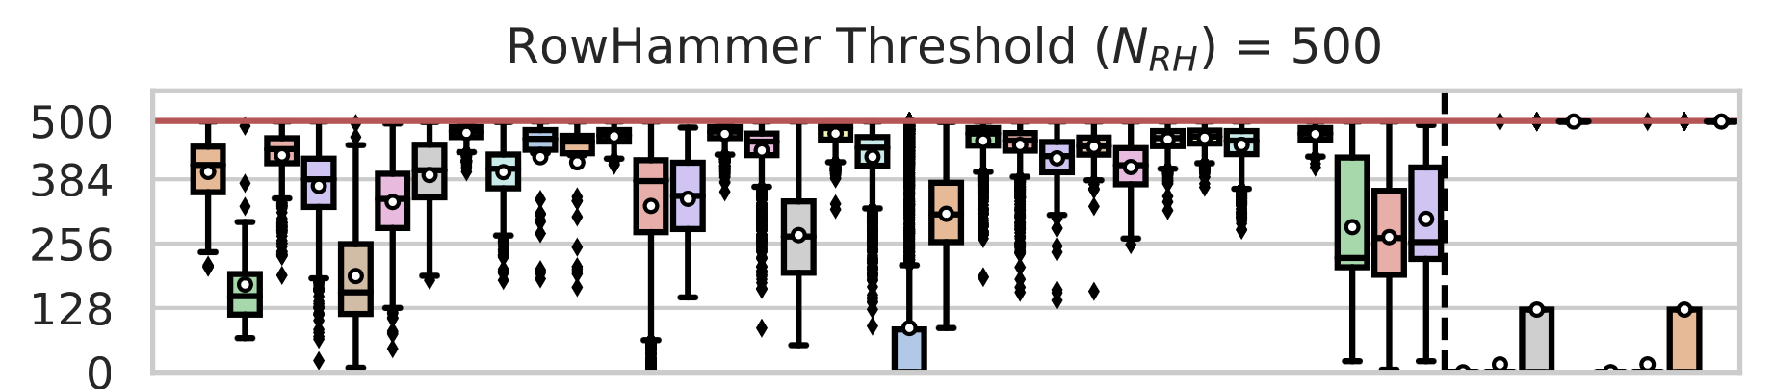
Sibling Row Activation Count
Sibling Row Activation Count
Workloads
If a row is activated RowHammer threshold (N_{RH}) times its siblings are likely activated more than N_{RH}/2 times
Notes:
This plot pictorially depicts our key observation across many tested [CLICK] workloads. I will not explain this in detail in the interest of time.
When a row gets activated RowHammer threshold times, which is 500 for this figure, we record the activation counts of that DRAM row’s siblings.
Each box in this plot shows the distribution of sibling rows’ activation counts for a tested workload.
[CLICK] Above the horizontal green line in the figure shows that [CLICK] if a row is activated RowHammer threshold times, its siblings are activated more than half the RowHammer threshold times.

Slide 84
Key Idea
There are many (e.g., 16) banks in a DRAM chip
Newer DRAM standards (DDR5) have more (32) banks
# of activation counters linearly increases with # of banks
Sibling rows have similar activation counts
Have one counter for all siblings
Reduce the number of counters by a factor of the number of banks
Bank 0
Bank 1
…
Bank 15
Bank 0-15
…
Counter X
Counter X
…
Counter X
Counter X
Existing Row Activation Tracker
ABACuS-Based Tracker
16x reduction in number of counters

Slide 85
ABACuS: Overview
Track the maximum (worst) activation count across all sibling rows using one counter
Notes:
ABACuS’s objective is to track the maximum activation count across all sibling rows using one counter

Slide 86
Key Components
Adopt a frequent item counting algorithm
Area-efficient, fewer counters to track more DRAM rows
ABACuS is compatible with other counting methods
ABACuS Counter Table
RowID
ABACuS Counter
Row Activation Counter (RAC)
Sibling Activation Vector (SAV)
N_{entries}
RowID
ABACuS Counter
…
…
…
…
…
…
…
RowID
ABACuS Counter
Spillover Counter

Slide 87
Operation
The RAC always stores the maximum activation count
Store small additional information in SAV
“Which siblings were activated since RAC was last incremented?” One bit per bank
ABACuS Counter
Row Activation Counter (RAC)
Sibling Activation Vector (SAV)
Increment only when a sibling is activated “again” (i.e., activate targets a set SAV bit)
Notes:
Recall that we want to keep track of the maximum activation count…
I will briefly explain the intuition
We have a proof in the paper.

Slide 88
Outline
1. Background & Motivation
2. ABACuS: Key Idea and Mechanism
3. Evaluation
4. Conclusion

Slide 89
Evaluation Methodology
Performance and energy consumption evaluation: Cycle-level simulations using Ramulator [Kim+, CAL 2015] and DRAMPower [Chandrasekar+, DATE 2013]
System Configuration:
Processor 1 or 8 cores, 3.6GHz clock frequency,
4-wide issue, 128-entry instruction window
DRAM DDR4, 1 channel, 2 rank/channel, 4 bank groups,
4 banks/bank group, 128K rows/bank, 3200 MT/s
Memory Ctrl. 64-entry read and write requests queues,
Scheduling policy: FR-FCFS with a column cap of 16 Last-Level Cache 2 MiB (single-core), 16 MiB (8-core)
Comparison Points: 4 state-of-the-art RowHammer mitigations
Graphene (best performing), Hydra (area-optimized best performing), Low Processor Chip Area Cost: REGA, PARA
Workloads: 62 1- & 8-core workloads
SPEC CPU2006, SPEC CPU2017, TPC, MediaBench, YCSB

Slide 90
Single-Core Performance and Energy
Small 0.6% average performance overhead at nRH = 1000 1.5% at nRH = 125
ENERGY

Slide 91
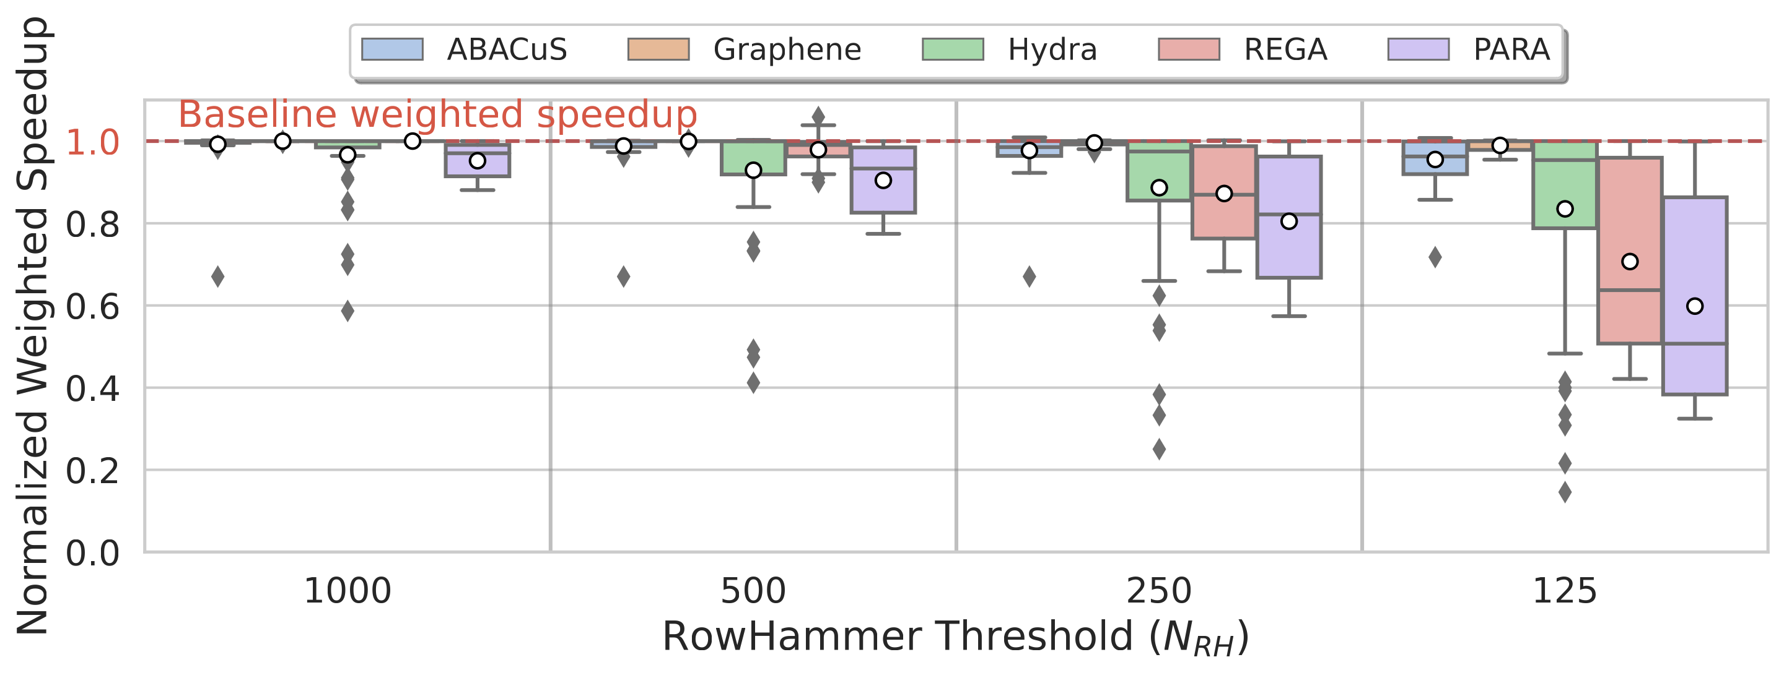
Multi-Core Performance

Slide 92
Storage and Area Overhead
ABACuS takes up 18.93 KiB at 1K and 151.41 KiB at 125 RowHammer threshold
Area overhead analysis: CACTI
Area overhead for a dual-rank system

Slide 93
More in the Paper
More motivational analysis
Multi-core performance & energy results
Performance under adversarial workloads
Alternative ABACuS design
Performance & energy sensitivity to:
Blast radius
Number of ABACuS counters
Number of banks
Circuit area, latency, energy, and power
Security proof

Slide 94
Outline
1. Background & Motivation
2. ABACuS: Key Idea and Mechanism
3. Evaluation
4. Conclusion

Slide 95
ABACuS Summary
Goal: Prevent RowHammer bitflips at low performance, energy, and area cost especially at very low RowHammer thresholds (e.g., 125 aggressor row activations induce a bitflip)
Key Observation: Many workloads access the same row address in different DRAM banks at around the same time
Key Idea: Use one counter to track the activation count of many rows with the same address across all DRAM banks
Key Results: At very low RowHammer thresholds, ABACuS:
Induces small system performance and DRAM energy overhead
Outperforms the state-of-the-art mitigation (Hydra)
Takes up 22.7X smaller chip area than state-of-the-art (Graphene)
https://github.com/CMU-SAFARI/ABACuS

Slide 96
Extended Version on arXiv
https://arxiv.org/pdf/2310.09977.pdf

Slide 97
ABACuS is Open Source
https://github.com/CMU-SAFARI/ABACuS

Slide 98
ABACuS All-Bank Activation Counters for Scalable and Low Overhead RowHammer Mitigation
Ataberk Olgun
Yahya Can Tuğrul
F. Nisa Bostancı
İsmail Emir Yüksel
Haocong Luo
Steve Rhyner
A. Giray Yağlıkçı
Geraldo F. Oliveira
Onur Mutlu

Slide 99
CoMeT Count-Min-Sketch-based Row Tracking to Mitigate RowHammer at Low Cost
F. Nisa Bostancı
I. E. Yüksel A. Olgun K. Kanellopoulos Y. C. Tuğrul
A. G. Yağlıkçı M. Sadrosadati O. Mutlu
https://github.com/CMU-SAFARI/CoMeT

Slide 100
Executive Summary
Problem: As DRAM becomes more vulnerable to read disturbance, existing RowHammer mitigation techniques either prevent bitflips
at low performance cost but with high area overheads or
at low area cost but with prohibitively large performance and energy overheads
Goal: Prevent RowHammer bitflips with low area, performance, and energy overheads in highly RowHammer-vulnerable DRAM-based systems
Key Idea: Use low-cost and scalable hash-based counters to accurately track DRAM rows
CoMeT:
tracks most DRAM rows with scalable hash-based counters by employing the Count-Min-Sketch technique to achieve a low area cost
tracks only a small set of DRAM rows that are activated many times with highly accurate per-DRAM-row activation counters to reduce performance penalties
Evaluation: CoMeT achieves a good trade-off between area, performance and energy costs
incurs significantly less area overhead (74.2×) compared to the state-of-the-art technique
outperforms the state-of-the-art technique (by up to 39.1%)
https://github.com/CMU-SAFARI/CoMeT

Slide 101
Outline
Background and Problem
Goal and Key Idea
CoMeT: Count-Min-Sketch-based Row Tracking
Evaluation
Conclusion

Slide 102
Read Disturbance Vulnerabilities (I)
DRAM Subarray
Row 0
Row 0
Victim Row
Row 1
Row 1
Row 1
Victim Row
Row 2
Row 2
Row 2
Row 2
Row 2
Row 2
open
open
open
closed
closed
Aggressor Row
Row 3
Row 3
Row 3
Victim Row
Row 4
Row 4
Victim Row
Repeatedly opening (activating) and closing (precharging)
a DRAM row causes RowHammer bitflips in nearby cells
Notes:
Todays DRAM chips are vulnerable to read disturbance
Where repeatedly opening and closing or activating and precharging the same DRAM row results in bitflips in nearby DRAM cells which we call the RowHammer bitflips

Slide 103
Read Disturbance Vulnerabilities (I)
DRAM Subarray
Row 0
Row 0
Victim Row
Row 1
Row 1
Row 1
Victim Row
Row 2
Row 2
Row 2
Row 2
Row 2
open
open
open
closed
Aggressor Row
Row 3
Row 3
Row 3
Victim Row
Row 4
Row 4
Victim Row
The minimum number of activations that causes a bitflip is called the RowHammer threshold

Slide 104
Read Disturbance Vulnerabilities (II)
DRAM chips are more vulnerable to read disturbance today
Read disturbance bitflips occur at much lower activation counts
(more than two orders of magnitude decrease in less than a decade):
139K
[Kim+, ISCA’14]
9.6K
[Kim+, ISCA’20]
<1K
[Luo+, ISCA’23]
Mitigation techniques against read disturbance attacks need to be effective and efficient for highly vulnerable systems

Slide 105
Existing RowHammer Mitigations (I): Preventive Refresh
DRAM Subarray
Row 0
Row 0
Row 0
Victim Row
Row 1
Row 1
Row 1
Row 1
Victim Row
Row 2
Row 2
Row 2
Row 2
Row 2
Row 2
open
open
open
closed
Aggressor Row
Aggressor Row
Row 3
Row 3
Row 3
Row 3
Victim Row
Row 4
Row 4
Row 4
Victim Row
Refreshing potential victim rows mitigates read disturbance bitflips

Slide 106
Existing RowHammer Mitigations (II): DRAM Row Activation Tracking
DRAM Subarray
Row 0
Row 0
Row 0
Victim Row
Row 1
Row 1
Row 1
Row 1
Victim Row
Row 2
Row 2
Row 2
Row 2
Row 2
Row 2
open
open
open
closed
Aggressor Row
Aggressor Row
Row 3
Row 3
Row 3
Row 3
Victim Row
Row 4
Row 4
Row 4
Victim Row
Mitigation techniques track DRAM row activation counts (of aggressor rows) to preventively refresh potential victim rows

Slide 107
Existing RowHammer Mitigations (III): Overview of Preventive Refresh-Based Mitigation Techniques
DRAM
Processor Chip
Processor Chip
Processor Chip
Shared Counters
Row A
Counter A
Tag A
Counter A
Tag A
Counter A
Row B
Counter B
Tag B
Counter B
Tag B
Counter B
Row C
Counter C
Tag C
Counter C
Row D
Counter D
CAM-based implementation
One ACT counter
per DRAM row
One ACT counter per aggressor row
<1 counter per DRAM row
VERY LOW
LOW
HIGH
Performance & Energy Costs
Many DRAM rows
(e.g., 128K per bank)
High DRAM bandwidth consumption
# of aggressor rows
increases significantly
Area Cost
VERY HIGH
HIGH
LOW

Slide 108
Existing RowHammer Mitigations (IV): Overhead Trade-Off of State-of-the-Art Mitigation Techniques
Notes:
Ideally, we would like to achieve low energy, processor chip and DRAM area and performance overheads
[CLICK]
As you can see from this radar chart

Slide 109
Existing RowHammer Mitigations (IV): Overhead Trade-Off of State-of-the-Art Mitigation Techniques
No existing mitigation technique prevents RowHammer bitflips at low area, performance and energy costs
Notes:
None of the existing mitigation techniques prevents RowHammer at low area performance and energy costs

Slide 110
Outline
Background and Problem
Goal and Key Idea
CoMeT: Count-Min-Sketch-based Row Tracking
Evaluation
Conclusion

Slide 111
Our Goal
Prevent RowHammer bitflips with low area, performance, and energy overheads in highly RowHammer-vulnerable DRAM-based systems
(e.g., a RowHammer threshold of 125)

Slide 112
Key Observation
Hash-based counters are low-cost:
can be implemented with low-cost structures and
can aggregate many rows' activation counts together
LOW COST
DRAM
1
Hash Function
(Example)
Counters
Row 0
Row 0
2
Row 1
0
1
2
3
Row 2
H(ID) = ID % 4
Row 3
Row 4
Row 4
Mapping without tags
Fixed number of counters
Tag-based counters are highly accurate:
Each one tracks one row's activation count
Tag
Counter
Row 0
Row 0
HIGH ACCURACY
…
Notes:
We observe that there are two types of counters
[CLICK]Hash based counters are low cost
[CLICK]And tag based counters are highly accurate
We want to get the best of both worlds
Now let me explain how these work

Slide 113
Key Idea
1
Use low-cost and scalable hash-based counters to track most DRAM rows' activations with low area overhead
2
Use highly accurate tag-based counters to track only a small set of DRAM rows to achieve low performance overhead

Slide 114
Outline
Background and Problem
Goal and Key Idea
CoMeT: Count-Min-Sketch-based Row Tracking
Evaluation
Conclusion

Slide 115
CoMeT Overview
Counter Table (CT):
Maps each DRAM row to a group of low-cost hash-based counters as uniquely as possible by employing the Count-Min Sketch technique
Triggers a preventive refresh to an aggressor row's victim rows when the aggressor's counter group reaches an activation threshold
Tracks DRAM row activations at low area cost
Recent Aggressor Table (RAT):
Allocates highly accurate per-DRAM-row counters for only a small set of DRAM rows that are activated many times
Reduces performance penalties by increasing tracking accuracy

Slide 116
Operation of CoMeT
ACT A
CoMeT
1
2
Counter Table
Recent Aggressor Table
Hash-based Counters
Tag-based Counters
Counter Table-Based Estimation
Recent Aggressor Table-Based
Estimation
used when there is a tag match
COMPARE
3
Row A's ACT Count to N_{PR}
preventive refresh threshold
Preventively Refresh
A's victim rows
Notes:
Lets look at a high level summary of how CoMeT operates
[CLICK] When there is an activation to row A, CoMeT first checks the counter table that implements hash-based counters
And gets [CLICK] an estimation based on the counter table
At the same time [CLICK] it checks the recent aggressor table that has tag-based counters
[CLICK] And gets another estimation from the recent aggressor table.
[CLICK] CoMeT uses the recent aggressor table based estimation when there is a tag match because the tag-based counters are more accurate
[CLICK] CoMeT compares the activation count estimation to a preventive refresh threshold
[CLICK]And preventively refreshes row A's victim rows if the estimation reaches the threshold value

Slide 117
Counter Table (CT): Count-Min-Sketch-based Row Tracking
Count-Min Sketch: A hash-based frequent item counting technique
Action Timeline
Counters
Counter Table
Hash Functions
0
1
2
3
4
ACT A
H₁
3
1
2
1
H₁(A) → 0
0 | 0 | 0 | 0 | 0
ACT A
H₁(B) → 4
ACT B
H₁(C) → 0
ACT C
COUNTER COLLISION
ESTIMATION
ACT_Count(A) = 3
causes overestimation
Actual ACT_Count(A) = 2
Notes:
Lets look into the Counter table in more detail
The counter table employs the count min sketch technique which is a hash based frequent item counting technique
That uses hash functions and a counter array per hash function
[CLICK] When we have an activation to Row A, Counter table first gets the output of the hash function using the row id as an input.
This output is used as an index for the counter array mapping the DRAM row to a counter.
[CLICK] And the counter table increments the indexed counter.
[CLICK] when we receive another activation to the same row, the hash outputs the same index and counter table increments the same counter
[CLICK] When we receive an activation to another row, ideally the output of the hash function maps th row to another counter
[CLICK] counter table increments that counter

Slide 118
Counter Table (CT): Count-Min-Sketch-based Row Tracking
To avoid overestimations, Counter Table implements multiple hash functions
Action Timeline
Counters
Counter Table
Hash Functions
0
1
2
3
4
ACT A
H₁
3
1
H₁(A) → 0
0 | 0 | 0 | 0 | 0
ACT A
H₂
H₁(B) → 4
H₃
2
1
1
ACT B
H₁(C) → 0
0 | 0 | 0 | 0 | 0
2
1
ACT C
0 | 0 | 0 | 0 | 0
1
ESTIMATION
ESTIMATION
CounterGroup_{A}
ACT_Count(A) = 3
ACT_Count(A) = 2
CounterGroup_{B}
CounterGroup_{C}
Actual ACT_Count(A) = 2
ESTIMATION
The minimum counter value is an upper bound for the actual activation count
ACT_Count(A) = MIN(CounterGroup_{A})
Notes:
Counter Table implements multiple hash functions that map DRAM rows to different counters
[CLICK] As a result, each DRAM row is mapped to a counter group [CLICK] as unique as possible [CLICK]
When there is an activation to a row, all counters in its counter group are incremented
[CLICK] therefore the minimum counter value is an upper bound of the actual activation count
[CLICK] so counter table estimates the activation count as the minimum counter value.
[CLICK] In this example, this estimation leads to estimating the act count of A as 2, which is the actual activation count

Slide 119
Counter Table (CT): Identifying Aggressor Rows
CoMeT sets a preventive refresh threshold (N_{PR} ) to timely refresh an aggressor row's victim rows to prevent bitflips
Action Timeline
Hash
Counters
Counter Table
Functions
0
1
2
3
4
ACT A
N_{PR}
H₁
0
ESTIMATION
N_{PR}
ACT_Count(A) = N_{PR}
H₂
0
N_{PR}
N_{PR}
N_{PR}
Identify A as an aggressor row
H₃
0
1
CounterGroup_{C}
2
Preventively refresh
A's victim rows
* N_{PR}: Preventive Refresh Threshold
CounterGroup_{A}
:
Reset counters?
ESTIMATION
ACT_Count(C) = 0

Slide 120

Counter Table (CT): Counter Saturation
CoMeT does not reset any counter in CT after preventive refresh
CT counters saturate at N_{PR}
Action Timeline
Hash
Counters
Counter Table
Functions
0
1
2
3
4
ACT A
H₀
N_{PR}
Preventively refresh
A's victim rows
H₁
N_{PR}
ACT A
H₂
N_{PR}
ESTIMATION
ACT_Count(A) = N_{PR}
* N_{PR}: Preventive Refresh Threshold
Preventively refresh
A's victim rows
CounterGroup_{A}
:
Actual ACT_Count(A) after preventive refresh is 0
can potentially incur performance and energy overheads

Slide 121
Recent Aggressor Table
Allocates per-DRAM-row counters for aggressor rows to accurately estimate their activation counts after preventive refreshes
Implemented for only a small set of DRAM rows to maintain a low area cost
Hash
Counters
Counter Table
Recent Aggressor Table
Functions
Row Tag
Counter
0
1
2
3
4
H₁
N_{PR}
A
0
H₂
N_{PR}
H₃
N_{PR}
TAG MATCH
* N_{PR}: Preventive Refresh Threshold
ESTIMATION
CounterGroup_{A}
:
ACT_Count(A) = 0
If a DRAM row has a Recent Aggressor Table entry, CoMeT estimates its activation count 100% accurately
1
Identify A as an aggressor row
2
Preventively refresh
A's victim rows
Allocate a Recent Aggressor Table entry
3

Slide 122
Operation of CoMeT
ACT A
CoMeT
1
2
Counter Table
Recent Aggressor Table
Hash-based Counters
Tag-based Counters
Counter Table-Based Estimation
Recent Aggressor Table-Based
Estimation
used when there is a tag match
COMPARE
3
Row A's ACT Count to N_{PR}
preventive refresh threshold
Preventively Refresh
A's victim rows

Slide 123
More Operational Details for CoMeT
Counter update policy
Periodic counter reset mechanism
Recent Aggressor Table eviction policy
Early preventive refresh at coarse granularity
Determining the preventive refresh threshold

Slide 124
More Operational Details for CoMeT
ACT A
CoMeT
1
2
Counter Table
Recent Aggressor Table
Hash-based Counters
Tag-based Counters
Counter Table-Based Estimation
Recent Aggressor Table-Based
Estimation
used when there is a row ID match
3
ESTIMATION
ACT_Count(A) == N_{PR}
preventive refresh threshold
https://arxiv.org/abs/2402.18769
Preventively Refresh
A's victim rows
https://github.com/CMU-SAFARI/CoMeT

Slide 125
Outline
Background and Problem
Goal and Key Idea
CoMeT: Count-Min-Sketch-based Row Tracking
Evaluation
Conclusion

Slide 126
Evaluation Methodology
Performance and energy consumption evaluation: cycle-level simulations using Ramulator [Kim+, CAL 2015] and DRAMPower [Chandrasekar+, DATE 2013]
System Configuration:
Processor 1 or 8 cores, 3.6GHz clock frequency,
4-wide issue, 128-entry instruction window
DRAM DDR4, 1 channel, 2 rank/channel, 4 bank groups,
4 banks/bank group, 128K rows/bank
Memory Ctrl. 64-entry read and write requests queues,
Scheduling policy: FR-FCFS with a column cap of 16 Last-Level Cache 8 MiB (single-core), 16 MiB (8-core)
CoMeT Counter Table: 4 hash functions 512 counters per hash Recent Aggressor Table: 128 entries
Comparison Points: 4 state-of-the-art RowHammer mitigations
Graphene (best performing), Hydra (area-optimized best performing), Low Processor Chip Area Cost: REGA, PARA
Workloads: 61 single-core applications and 56 8-core workload mixes
SPEC CPU2006, SPEC CPU2017, TPC, MediaBench, YCSB
https://github.com/CMU-SAFARI/CoMeT

Slide 127
Hardware Implementation
Storage and area overhead analysis: CACTI
Dual-rank area overhead comparison:
0.89
4.89
5.4×
74.2×
Significantly less area overhead
CoMeT stores fewer bits as the RowHammer threshold decreases
Similar area overheads
CoMeT incurs a significantly less area overhead than Graphene and a similar area overhead to Hydra

Slide 128
Performance and DRAM Energy
Average performance and DRAM energy overheads of CoMeT across single-core applications
2.07%
4.01%
CoMeT prevents bitflips with very small average performance and DRAM energy overheads compared to a baseline system with no RowHammer mitigation
Notes:
We evaluate the average performance and DRAM energy overheads of CoMeT across single core applications
[CLICK] This is CoMeT's performance normalized to a system with no RH mitigation across different RH thresholds [CLICK]
As RH threshold decreases CoMeT has a small performance overhead due to preventive refreshes as opposed to the baseline that does not do preventive refresh
[CLICK] This is CoMeT's DRAM energy consumption normalized to the same baseline [CLICK] and it shows a similar result
[CLICK] We conclude that CoMeT prevents bitflips with very small average performance ….

Slide 129
Performance Comparison: Single-Core Applications
1.75%
1.75%
CoMeT outperforms all low-area-cost mitigations starting from the RowHammer threshold of 500
(average)
CoMeT incurs a small performance overhead (≤ 1.75%) over Graphene and outperforms Hydra (by up to 39.1%) at all RowHammer thresholds

Slide 130
Performance Comparison: 8-Core Workloads
Trends are similar to single-core application evaluation trends

Slide 131
DRAM Energy Comparison: Single-Core Applications
CoMeT consumes less DRAM energy than all low-area-cost mitigations for all RowHammer thresholds
1.88%
0.39%
0.04%
0.96%
CoMeT incurs a small DRAM energy overhead (<1%) over Graphene and consumes less DRAM energy than Hydra

Slide 132
DRAM Energy Comparison: 8-Core Workloads
Multicore energy trends are similar to single core energy trends

Slide 133
More in the Paper
Security Analysis of CoMeT
Sensitivity Analysis
Counter Table Configurations
Recent Aggressor Table Configurations
Counter Reset Period and Preventive Refresh Threshold Values
CoMeT's Performance under Adversarial Workloads
Comparison against Throttling-Based Mitigation Techniques
CoMeT's Performance at High RowHammer Thresholds

Slide 134
More in the Paper
Security Analysis of CoMeT
Sensitivity Analysis
Counter Table Configurations
Recent Aggressor Table Configurations
Counter Reset Period and Preventive Refresh Threshold values
Performance Evaluation under Adversarial Workloads
Performance Evaluation Comparison against Throttling-Based Mitigation Techniques
Performance Evaluation at High RowHammer Thresholds
https://arxiv.org/abs/2402.18769

Slide 135
CoMeT is Open Source and Artifact Evaluated
https://github.com/CMU-SAFARI/CoMeT

Slide 136
Outline
Background and Problem
Goal and Key Idea
CoMeT: Count-Min-Sketch-based Row Tracking
Evaluation
Conclusion

Slide 137
Conclusion
Goal: Prevent RowHammer bitflips with low area, performance, and energy overheads in highly RowHammer-vulnerable DRAM-based systems
Key Idea: Use low-cost and scalable hash-based counters to accurately track DRAM rows
CoMeT:
tracks most DRAM rows with scalable hash-based counters by employing the Count-Min-Sketch technique to achieve a low area cost
tracks only a small set of DRAM rows that are activated many times with highly accurate per-DRAM-row activation counters to reduce performance penalties
Evaluation: CoMeT achieves a good trade-off between area, performance and energy costs
incurs significantly less area overhead (74.2×) compared to the state-of-the-art technique
outperforms the state-of-the-art technique (by up to 39.1%)
https://github.com/CMU-SAFARI/CoMeT

Slide 138


CoMeT Count-Min-Sketch-based Row Tracking to Mitigate RowHammer at Low Cost
F. Nisa Bostancı
I. E. Yüksel A. Olgun K. Kanellopoulos Y. C. Tuğrul
A. G. Yağlıkçı M. Sadrosadati O. Mutlu
Paper Link
GitHub Repo

Slide 139
CoMeT Count-Min-Sketch-based Row Tracking to Mitigate RowHammer at Low Cost
BACKUP SLIDES
F. Nisa Bostancı
I. E. Yüksel A. Olgun K. Kanellopoulos Y. C. Tuğrul
A. G. Yağlıkçı M. Sadrosadati O. Mutlu
Paper Link
GitHub Repo

Slide 140
DRAM Organization
DRAM Chip
…
Subarray
Bitline
DRAM Cell
Bank
Wordline
Chip I/O
. . .
…
DRAM Row
…
…
…
…
…
…
Row Buffer
DRAM Chip
DRAM Bank
DRAM Subarray

Slide 141
Read Disturbance Vulnerabilities
DRAM Subarray
The minimum number of row activations needed to cause a bitflip (i.e., RowHammer threshold (N_{RH} )) has reduced by more than an order of magnitude in less than a decade
[Kim+ ISCA'20]
Row 0
Row 0
Victim Row
Row 1
Row 1
Row 1
Victim Row
Row 2
Row 2
Row 2
Row 2
Row 2
Row 2
open
open
open
closed
closed
Aggressor Row
RowPress is shown to lead to bitflips with one to two orders of magnitude fewer activations (than RowHammer) under realistic conditions
[Luo+ ISCA'23]
Row 3
Row 3
Row 3
Victim Row
Row 4
Row 4
Victim Row
Repeatedly opening (activating) and closing (precharging)
a DRAM row causes RowHammer bitflips in nearby cells

Slide 142


Existing RowHammer Mitigations (II): Performance Optimized Mitigations
Accurately tracking DRAM row activations can be done by allocating per-row counters to potential aggressor rows
DRAM rows
TAG | Counter
TAG | Counter
the number of potential aggressor rows
total number of DRAM rows
Accurate tracking enables low performance overhead by reducing unnecessary preventive refreshes
At low N_{RH}
the number of potential aggressor rows increases significantly
A tag-based counter has a high area cost
As DRAM becomes more vulnerable to read disturbance, tracking all potential aggressor rows with tag-based counters results in a high area overhead

Slide 143
Existing RowHammer Mitigations (III): Area Optimized Mitigations: Hydra
DRAM rows
Memory Controller
DRAM
Group Counters and Filtering Mechanism
TAG | Counter
Per-DRAM-row counters
Increased off-chip communication
Low chip area overhead
Incurs DRAM storage overhead
As DRAM becomes more vulnerable to read disturbance, increased off-chip communication results in high performance and energy overheads

Slide 144
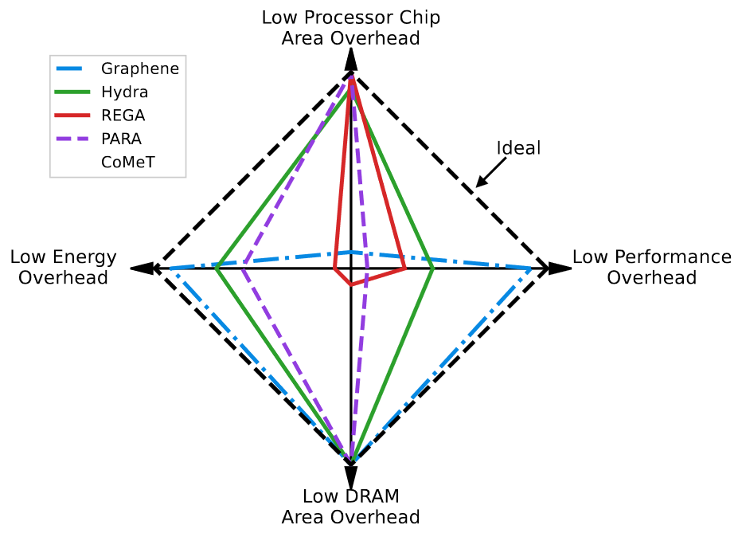
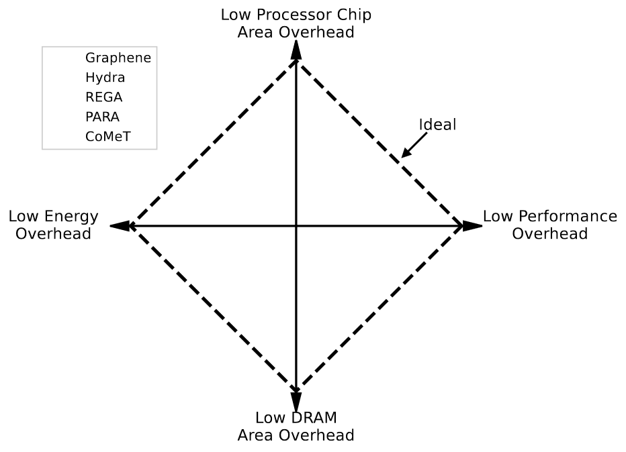
Limitations of Existing Mitigations
High area cost
due to many and expensive per-DRAM-row activation counters
High performance and energy costs
due to occupying the memory bandwidth with additional requests
No existing mitigation technique prevents RowHammer bitflips at low area, performance and energy costs

Slide 145
Operation of CoMeT
ACT A
CoMeT
Hash
Counters
1
Counter Table
Recent Aggressor Table
Functions
2
Row Tag
Counter
0
1
2
3
4
H₀
H₁
CounterGroup_{A}
H₂
TAG MATCH
CT ESTIMATION
RAT ESTIMATION
ACT_Count(A) = MIN(CounterGroup_{A})
ACT_Count(A) = RAT_Counter(A)
ESTIMATION
used when there is a tag match
ACT_Count(A) == N_{PR}
3
Preventively Refresh
A's victim rows
preventive refresh threshold

Slide 146
CoMeT Overview
CoMeT
ACT Row X
1
Counter Table
Recent Aggressor Table
2
H₀(X)=0 → C₀₀,
H₁(X)=2 → C₁₂,
…
DRAM Row Tag | Counter
CG(X):
3
Row ID X
0
1
2
m-1
N_{RAT_Entries}
H₀
C₀₀
 |  | C₁₂
…
H₁
…
5
Tag Match
RAT_Ctr
…
…
H_{k-1}
…
6
SELECT
Comparator
4
Num_ACT
≥
N_{PR}
Min_Ctr
7
Y: Preventive Refresh
Memory Request Scheduler

Slide 147
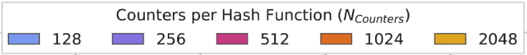


Configuring CoMeT – Sensitivity Analysis: Counter Table and Recent Aggressor Table
Configuring Counter Table
Configuring RAT

Slide 148
Configuring CoMeT – Sensitivity Analysis: Counter Table and Recent Aggressor Table
Configuring Counter Table
CoMeT configuration that achieves both performance and area efficiency:
Counter Table with 4 hash functions and 512 counters per hash function
Recent Aggressor Table with 128 entry
(more analyses in the paper)
Configuring RAT

Slide 149



Configuring CoMeT – Sensitivity Analysis: Counter Reset Period and N_{PR}
$$Counter Refresh Period= \frac{tREFW}{k}$$
(1)
$$N_{PR}=\frac{N_{RH}}{k+1}$$
(2)

Slide 150

The effect of EPRT and RAT Miss History Length on Performance and DRAM energy consumption

Slide 151

Hardware Implementation
Storage and area overhead analysis: CACTI
Logic circuitry overhead: Verilog HDL implementation and Synopsys DC
Dual-rank area overhead comparison:
As N_{RH} decreases, CoMeT's area and storage overheads decrease due to storing fewer bits for its counters

Slide 152
Hardware Implementation
Storage and area overhead analysis: CACTI
Logic circuitry overhead: Verilog HDL implementation and Synopsys DC
Dual-rank area overhead comparison:
Compared to the best performing state-of-the-art mitigation, CoMeT induces significantly less area overhead

Slide 153
Hardware Implementation
Storage and area overhead analysis: CACTI
Logic circuitry overhead: Verilog HDL implementation and Synopsys DC
Dual-rank area overhead comparison:
Compared to the best performing low-area-cost mitigation, CoMeT induces similar area overhead

Slide 154

Single-Core Performance Workload Breakdown (Medium and High Intensity)

Slide 155

Single-Core DRAM Energy Workload Breakdown (Medium and High Intensity)

Slide 156

Adversarial Access Patterns
0.7%
(over the baseline)
42.1%
CoMeT incurs negligible additional performance overhead on benign workloads when a traditional RowHammer attack is running at the same time

Slide 157

Comparison Against BlockHammer (I) Tracker Comparison
CoMeT and BlockHammer employs different algorithms and this results in different DRAM-row-to-counter mappings
Average # of unique rows that are activated at least 125 times by benign workloads
the average number of unique rows touched at least once by benign workloads
When tracking at most 2,500 unique rows,
CoMeT’s tracker outperforms BlockHammer
Notes:
We observe the total number of accesses in a refresh window is 10,000 on average across benign single-core workloads we evaluate

Slide 158

Comparison Against BlockHammer (II) Single-Core Performance Comparison
9.5%
CoMeT outperforms BlockHammer due to BlockHammer's (i) high false positive rate and (ii) increased memory request latencies due to throttling

Slide 159
Performance Comparison: 8-Core Workloads
0.9%
14.9%
11.9%
CoMeT's performance overhead over Graphene is 0.9% and 14.9% at N_{RH} = 1K and 125, respectively
CoMeT outperforms Hydra for all RowHammer thresholds (by up to 3.2× and 11.9% on average at N_{RH} = 125)
CoMeT outperforms all low-cost RowHammer mitigations starting from N_{RH}=250

Slide 160
Performance Comparison: 8-Core Workloads
More preventive refreshes
0.9%
14.9%
CoMeT outperforms all low-area-cost mitigations starting from the RowHammer threshold of 250
11.9%
CoMeT maintains a performance overhead between Graphene's and Hydra's performance overheads

Slide 161

Single-Core Comparison – Radar Chart

Slide 162

Multi-Core Comparison – Radar Chart

Slide 163

Evaluated Workloads and Their Characteristics

Slide 164

CoMeT's Performance at High RowHammer Thresholds

Slide 165

Summary of the Results

Slide 166

Storage Overhead of Graphene

Slide 167

Performance Overhead of Hydra

